Slide 1
IPH-202: Mathematical-III
Unit-I:Vector Calculus
By:
Dr. Nupur Saxena
CSIR-Senior Research Associate (Pool Scientist)
Department of Physics and Astronomical Sciences
Central University of Jammu, Jammu
Email: n1saxena@gmail.com

Slide 2
Contents:
I.1 Vectors’ recap
I.2 Scalar and Vector Fields
I.3 Vector Differentiation
I.4 Del (∇) and Laplacian (∇²) Operators
I.5 Gradient of Scalar Field and its Geometrical Interpretation
I.6 Directional and Normal Derivative
I.7 Divergence and Curl of a Vector Field
I.8 Vector Integration: Line, Surface and Volume
I.9 Theorems of Vector Integration: Gauss, Green and Strokes

Slide 3
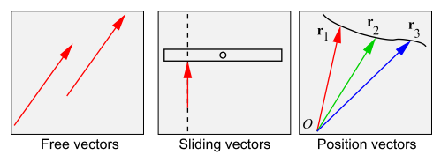
I.1 Vectors’ Recap
A Physical quantity having magnitude as well as direction is referred as Vector quantity and is represented by vector notations and follows rules of vector algebra.
There are three slightly different types of vectors:
– Free vectors: Only magnitude & direction are important. We can translate at will.
– Sliding vectors: Line of action is important (e.g. forces for moments) Vector can slide with 1 degree of freedom.
– Bound or position vectors: “Tails” all originate at origin O.

Slide 4
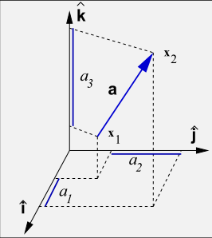
I.1 Vectors’ Recap
• In a Cartesian coordinate frame
a = [a₁ , a₂ , a₃ ] = [x₂ − x₁ , y₂ − y₁ , z₂ − z₁]
• Define as unit vectors in the x, y, z directions
= [1, 0, 0] = [0, 1, 0] = [0, 0, 1]
Then a = a₁ + a₂ + a₃ .
Two free vectors are said to be equal if and only if their lengths and directions are the same.
• Using coordinates, two n-dimensional vectors are equal
a = b if and only if a₁= b₁ , a₂ = b₂ , . . . a_{n} = b_{n}
• This does for position vectors.
• But for sliding vectors we must add the line of action must be the same.
Provided we use an orthogonal coordinate system, the magnitude of a 3-vector is
and of an n-vector
• To find the unit vector in the direction of a, simply divide the vector by its magnitude

Slide 5
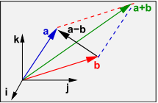
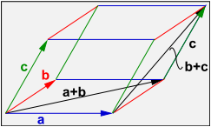
I.1 Vectors’ Recap
Vectors are added/subtracted by adding/subtracting corresponding components (like matrices)
i.e. a + b = [a₁ + b₁, a₂ + b₂, a₃ + b₃]
• Addition follows the parallelogram construction.
• Subtraction is a + ( − b).
• The following results follow immediately from the above definition of vector addition (incl. subtraction).
1. a + b = b + a (it commutes)
2. (a + b) + c = a + (b + c) = a + b + c (it associates)
3. a + 0 = 0 + a = a, where the zero vector is 0 = [0, 0, 0].
4. a + (-a) = 0
Multiplication of a vector by a scalar is NOT the scalar product
• Just as for matrices, multiplication of a vector a by a scalar c is defined as multiplication of each component by c, so that
ca = [ca₁, ca₂ , ca₃ ].
It follows that:
• The direction of the vector will reverse if c is negative, but otherwise is unaffected.

Slide 6
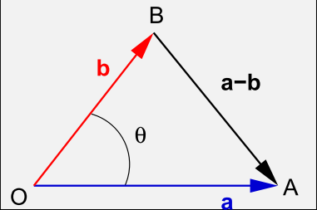
I.1 Vectors’ Recap
Scalar product or dot product
• The scalar product of two vectors results in a scalar quantity: a · b = a₁b₁ + a₂b₂ + a₃b₃.
• Note that
• These properties of the scalar product follow immediately:
a · b = b · a (it commutes)
a· (b + c) = a · b + a · c (it distributes w.r.t. vector addition)
(λa) · b = λ(a · b) = a · (λb) (scalar multiple of a scalar product of two vectors)
• Consider the square magnitude of the vector (a − b).
• The cosine rule says length AB² is |a − b|² = a² + b² − 2abcos θ
• Hence a · b = abcos θ, independent of the coordinate system.
• Conversely cos θ = a · b/ab
bcos θ is the component of b in the direction of a.
acos θ is the component of a in the direction of b.

Slide 7
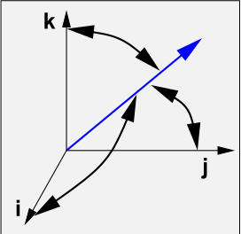
I.1 Vectors’ Recap
Projection is very useful when the second vector is a unit vector.
is the size of the component of a in the direction of
To get the vector component of b in the direction of a:
So is the vector component of a in the direction of
• In the particular case a · b = 0, the angle between the two vectors is a right angle.
• The vectors are said to be orthogonal — neither has a component in the direction of the other.
• In 3D, an orthogonal coordinate system is characterized by and
Direction cosines
• The quantities
are the cosines of the angles which the vector a makes with the coordinate vectors
• They are the direction cosines of the vector a.
• Since etc, it follows immediately that

Slide 8
I.1 Vectors’ Recap Cross Product
v x u
Cross product between vector v and u gives a vector
is a unit vector perpendicular to both u and v.
Follow the right-hand rule.
u and v are parallel if
The length of the cross product equals the area of the parallelogram determined by u and v
A determinant with two equal rows has value zero, so
a × a = 0
It is also easily verified that (a × b) · a = (a × b) · b = 0 so that a × b is orthogonal to both a and b.
• The vector product does not commute, It anti-commutes: a × b = − b × a.
• The vector product does not associate:
a × (b × c) ≠ (a × b) × c.
Note the cyclic order in
u
v
u x v

Slide 9
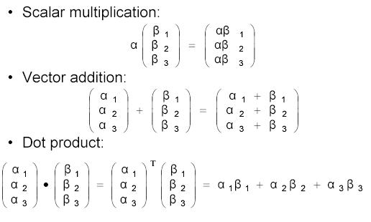
I.1 Vectors’ Recap Operation Calculation

Slide 10
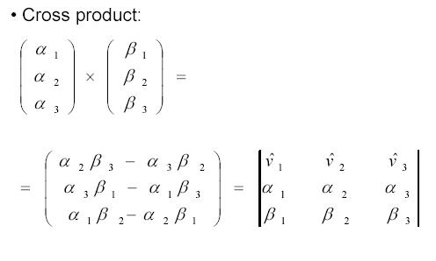
I.1 Vectors’ Recap Operation Calculation

Slide 11
I.2 Scalar and Vector Fields
The term field refers to a quantity that has values at all points of a region.
If the quantity which is assigned a value at all points of a spatial region (or function) is scalar, the field is referred as scalar field and if it is a vector quantity, its distribution is described as a vector field.
Examples: Scalar field: 1. Gravitational field due to mass 2. Temperature etc.
Vector field: 1. Electric field 2. Magnetic field etc.
I.3 Vector Differentiation
Can be performed on vector fields.
Play a basic role in the applications of vector calculus to fluid flow, electricity, and magnetism.
Let A(r) be a vector depending on coordinates (x, y, z) as , then
is the partial differentiation of A(r) and the individual terms are referred as partial derivatives.
The derivative of A(r) is obtained by differentiating each component separately as

Slide 12
I.3 Vector Differentiation
Formulae:

Slide 13
I.4 Del (∇) and Laplacian (∇²) Operators
Operator ∇ is called vector differential operator, defined as
Operator ∇² is called Laplacian operator, defined as
If A and B are two scalars, then

Slide 14
I.5 Gradient of Scalar Field and its Geometrical Interpretation
If φ (x,y,z) is a scalar function of three variables and is φ differentiable, the gradient of φ is defined as
Note that
Geometrical Interpretation:
The gradient of a scalar function represnts its maximum rate of change along its normal.
If a surface φ (x, y, z) = c passes through a point P. The value of the function at each point on the surface is the same as at P. Then such a surface is called a level surface through P.
Two level surfaces can not intersect.
Let the level surface pass through the point P at which the value of the function is φ. Consider another level surface passing through Q, where the value of the function is φ+d φ.
Let and be the position vector of P and Q then
∇φ.d = ……. (1)
R
Q
δn
φ+dφ = c
P
φ = c

Slide 15
I.6 Directional and Normal Derivative
If Q lies on the level surface of P, then dφ = 0. Equation (1) becomes ∇φ.d = 0.
Then ∇φ is ⊥ to d (tangent). Hence ∇φ is normal to the surface φ (x, y, z) = c.
Let ∇φ = , where is a unit normal vector. Then the rate of change of φ in the direction of the normal to the surface through P is
∴ Hence, gradient φ is a vector normal to the surface φ = c and has a magnitude equal to the rate of change of φ.
The component of ∇φ in the direction of a vector is equal to ∇φ. and is called the directional
derivative of φ in the direction of .
If φ (x, y, z) = c represents a family of surfaces for different values of the constant c. On differentiating φ, we get dφ = 0
But dφ = ∇φ.d so ∇φ.d = 0
The scalar product of two vectors ∇φ and d being zero, ∇φ and d are perpendicular to each other. d is in the direction of tangent to the given surface.
Thus ∇φ is a vector normal to the surface φ(x, y, z) = c and is called normal derivative.

Slide 16
I.7 Divergence and Curl of a Vector Field
Each operation resembles differentiation. However, one produces a scalar field whereas the other produces a vector field.

Slide 17
Some “divergence rules”:
(i)
(ii)
(iii)
(iv)
Physical interpretation of Divergence:
If A(x, y, z) is the velocity of a fluid (or gas), div A(x, y, z) represents the net rate of change (with respect to time) of the mass of fluid (or gas) flowing from the point (x, y, z) per unit volume.
In other words, div A(x, y, z) measures the tendency of the fluid to diverge from the point (x, y, z).

Slide 18
Some “divergence rules”: (i) (ii)
(iii) (iv)
Curl:
If A is conservative, then curl A = 0.
The reason for the name curl is that the curl vector is associated with rotations.
If curl A = 0 at a point P, the fluid is free from rotations at P. A is called irrotational at P.

Slide 19
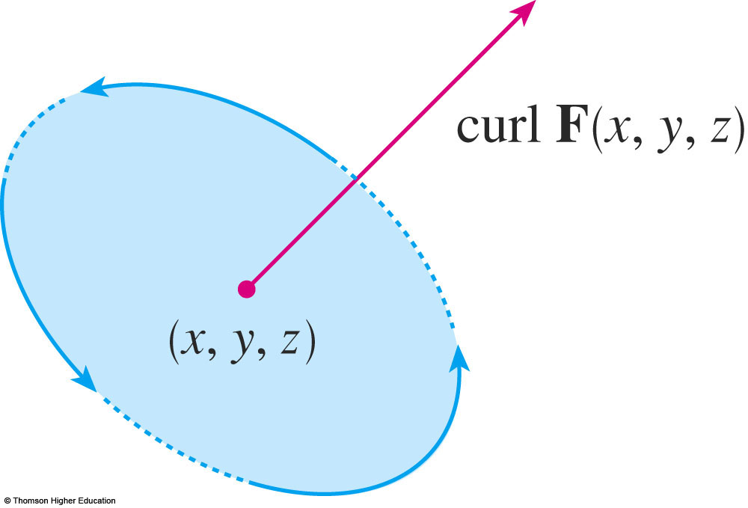
Physical interpretation of Curl
Particles near (x, y, z) in the fluid tend to rotate about the axis that points in the direction of curl F (x, y, z).
The length of this curl vector is a measure of how quickly the particles move around the axis.

Slide 20
I.8 Vector Integration: Line Integral
Ordinary integral ∫ f (x) dx, we integrate along the x-axis. But for line integral, the integration is along a curve.
∫ f (s) ds = ∫ f (x, y, z) ds
A
B
Let a vector field
and
The scalar product is written as
O

Slide 21
I.8 Vector Integration: Surface Integral
If vector field defeated on surface S, surface integral of S is defined as
I.8 Vector Integration: Volume Integral
If V is a closed region and , vector field in region V, Volume integral of V is

Slide 22
I.9 Theorems of Vector Integration:
Gauss’ Divergence Theorem
If S is a closed surface including region V in vector field
It relates volume integral with surface integral.

Slide 23
I.9 Theorems of Vector Integration:
Green’s Theorem
If c is a closed curve in counter-clockwise on plane-xy, and given two functions P(x, y) and Q(x, y),
where S is the area of c.

Slide 24
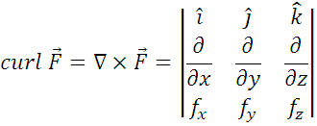
I.9 Theorems of Vector Integration:
Stokes’s Theorem
If is a vector field on an open
surface S and boundary of
surface S is a closed
curve c, therefore
It relates surface integral with line integral.

Slide 25
Thanks

