Slide 1
Children’s Literature (PGECL2E007T)
Raj Gaurav Verma

Slide 2
Defining Childhood
Childhood can be defined as:
the first phase in human life
as a stage of dependency
as a period of innocence
as a period after birth, extending to adolescence, and ending in adulthood when one begins to acquire a sense of self and identity

Slide 3
“Childhood is a variable of social analysis. It can never be divorced from other variables such as class, gender, or ethnicity. Comparative and cross-cultural analysis reveals a variety of childhoods rather than a single and universal phenomenon” –Allison James and Allan Prout
“If the word ‘literature’ presents obvious problems, the word ‘children’ proves to be equally slippery. The notion of childhood changes from place to place, from time to time, and the history, definition and study of childhood as a concept has burgeoned in recent years” – Peter Hunt

Slide 4
History of Childhood in the West
Centuries of Childhood : A Social History of Family Life (1960)- Philippe Aries, medievalist French historian.
Aries surveyed medieval paintings, architecture, furniture, school records, sculpture and gravestones dating back from the 12th century to the 17th Century.

Slide 5
Representation of Children in Various Ages
12th Century- No room for children→ Theological→
Cycle of birth, life and death → Thus, leaving no room for
childhood.
13th Century- Perception improved but did not go beyond the representation in sizes → Children were “but only men on a reduced scale” → Children as Mini-Adults
14th Century- 1. Children as “adolescent angels”
2. The Infant Jesus, or the Infant Notre-Dame
3. The naked child: Gothic period
4. “Angel-cum-altar-boy”
15th Century- “Angel-cum-altar-boy”- this image continued

Slide 6
16th Century— marks a transition in social and philosophical aspect attached to childhood in Europe → John Locke “An Essay Concerning Human Understanding” → Tabula Rasa
Locke writes: “children may be cozened into a knowledge of the letters; be taught to read, without perceiving it to be anything but a sport, and play themselves into that which others are whipped for.”
By the late 18th century, however, children were specially employed at the factories and mines and as chimney sweeps.
19th Century— childhood was romanticized. → children began to be represented as embodiments of innocence clearly differing from adults in their physical appearance and emotional make up
Late 19th century-The modern concept of childhood began to emerge

Slide 7
Children’s Literature which till now had been solely seen as pedantic and didactic, became humorous, imaginative and fantastic.
Industrial Revolution→ wide chasm between the lofty romantic ideals related to childhood and the reality of mounting exploitation of children at the workplace.
20th Century- Modern Education System
Public Schooling-State endeavour
Childhood as a time of fun of happiness

Slide 8
Conceptions of Childhood
Theological (Renaissance)
Pantheistic (Romantic)
Utilitarian (Victorian)
Psychological (Modern)
Individualistic (Postmodern)

Slide 9
Types of Children’s Literature
Picture Books
Traditional Literature
Fiction
Non-Fiction
Biography (including autobiography)
Poetry and Verse

Slide 10
Genres: in Children’s Fiction
Fairy-tales
Realistic Fictions (School and Domestic Stories)
Adventure Stories
Fantasy
Detective Fiction
Science Fiction

Slide 11
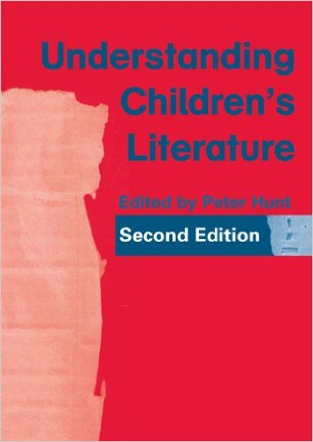
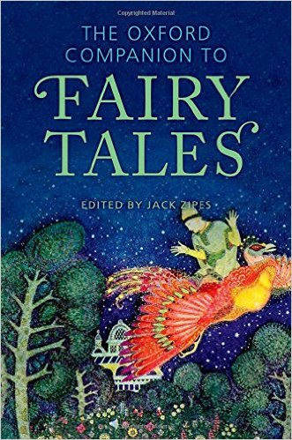
UNIT I

Slide 12
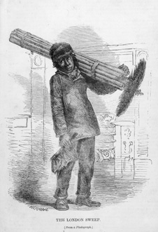
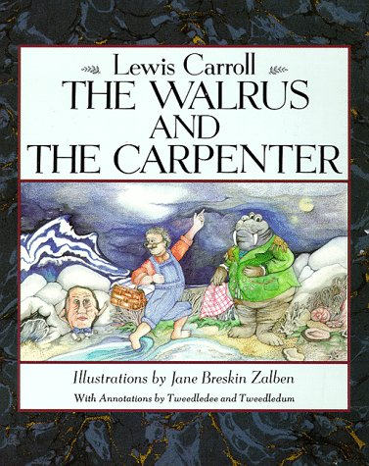
UNIT II

Slide 13
UNIT II
The romantic notion of Nature and “innocence” → essential in formation of identity
Landscape and Mindscape
Utilitarian Notion of Childhood
John Locke
Rousseau
Blake and Wordsworth (The Romantic Child)
Lewis Carroll (The Victorian Child)

Slide 14
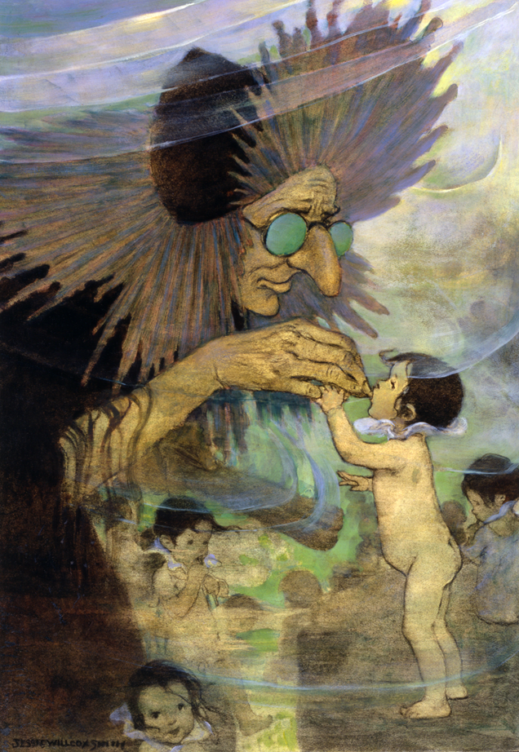
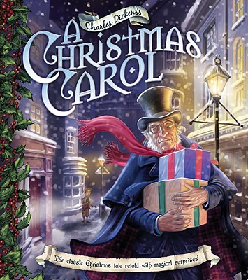
UNIT III

Slide 15
UNIT III
A Christmas Carol
An allegory
The time scheme
A social commentary
Christmas: the moral, social, aesthetic, and religious aspects of the holiday
A ghost story
Humour and Signiifcance of spirits
Treatment of Wealth
Water Babies
Style of Victorian-era
novels
Didactic Moral Fable
A satire on Science
Tract against Child Labour
Problem of Race and Class

Slide 16
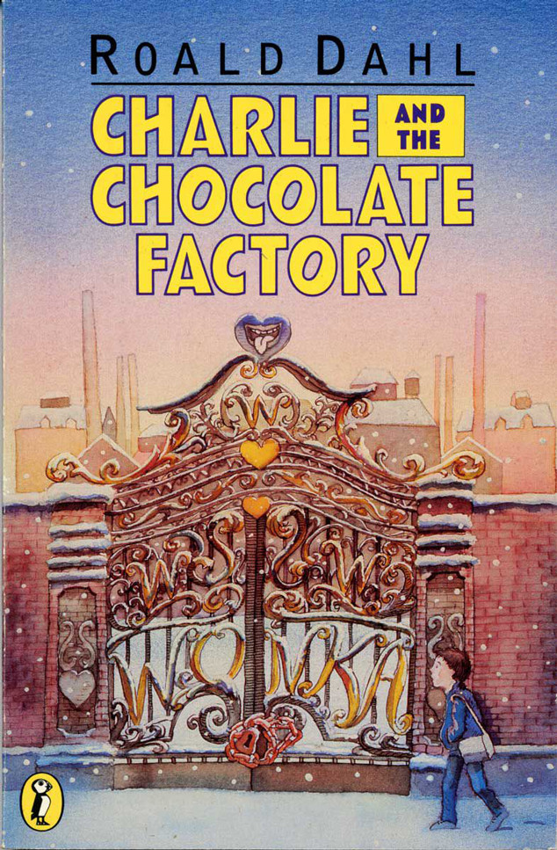
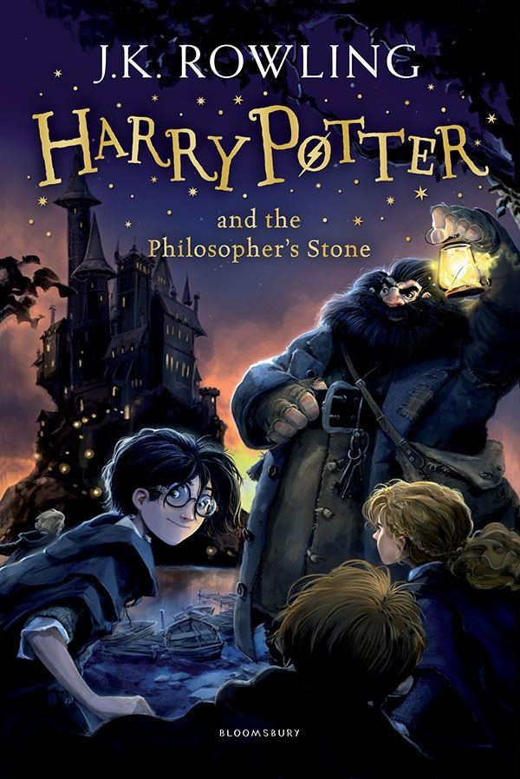
UNIT IV

Slide 17
UNIT IV
Charlie and the Chocolate Factory
Good Things Come in Small Packages
Poverty vs. Wealth
What Goes Around Comes Around
Charlie the hero of this story
Vice, Punishment and Absurdity
Harry Potter Book One
The Value of Humility
The Occasional Necessity of Rebellion
The Dangers of Desire
Hogwarts world compare with the Muggle world
Harry, Hermione and Ron

Slide 18
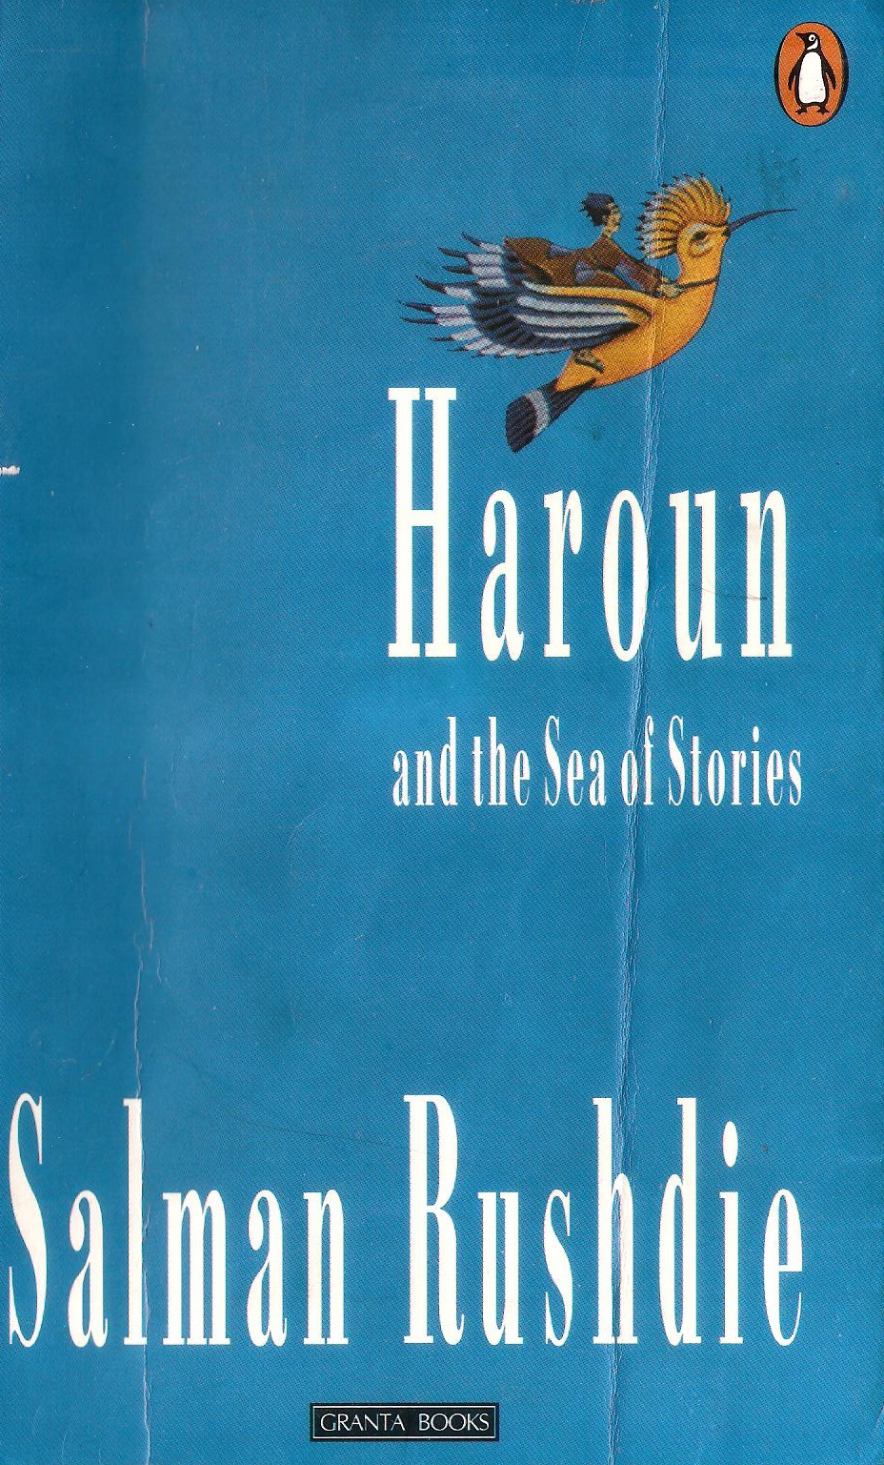
UNIT V

Slide 19
Making a Mango Whistle
Notion of Child as a Colony (Victorian Notion)
Child as a Miniature Adult
Making a Mango Whistle as a Domestic Story
The Context: Poverty, Misery, Hunger, Calamities
Colonial Childhood- Durga and Apu
Brother-Sister relationship
Gender Approach and Children’s Literature
Education System

Slide 20
Haroun and the Sea of the Stories
Haroun and the Sea of the Stories
A Postmodern Fairytale
Political Allegory (The Chuppies and The Guppies)
Moral Allegory (The Darkness and The Light)
Father-Son Relationship (Haroun and Rashid Khalifa)
A Fantasy (The Land of Kahani)
Man-environment relationship (Contamination of the Ocean

Slide 21
Thank You!: All the Best
To Remember
Hard work always pays
Think more, speak less

