Slide 1
Literary History of English
Central University of Jammu
Course: Foundation
Semester: I
Dept. of English
Course Instructor
Dr Jeet Singh

Slide 2
English Literary History
Overview - Epochs of British Literature and Culture
Old English Literature
• Middle English Literature •
The Renaissance
• The Seventeenth-Century – The Early Seventeenth Century – English Revolution and Commonwealth Period – Restoration
• The Eighteenth-Century
• Romanticism
• Victorianism
• Modernism
• Post-1945

Slide 3
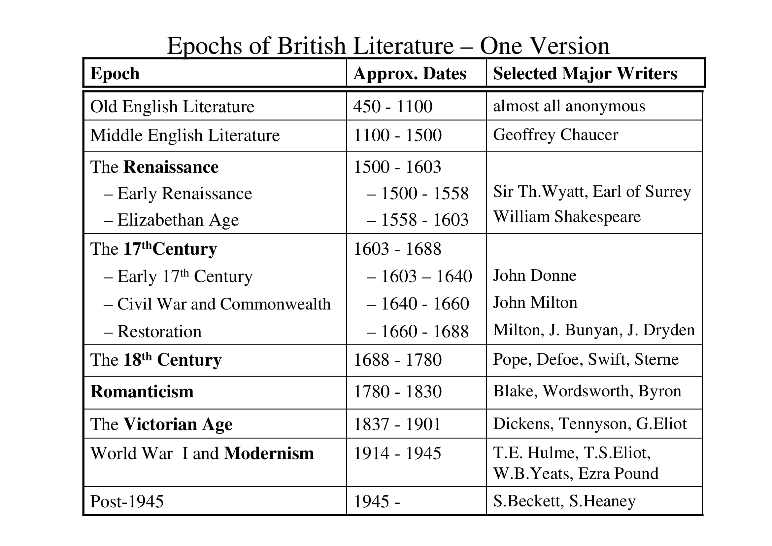

Slide 4
Old English Literature (450 - 1100)
All anonymous, mostly oral poetry; little has survived
Poetry does not rhyme; alliteration is the central principle
Beowulf (800), a heroic epic in alliterative verse
Caedmon's Hymn as the earliest extant Old English poem (a prayer), 660-680)

Slide 6
Middle English Literature (1100 - 1500)
1066: the Norman Conquest: William the Conqueror invades England; the Normans begin to rule England
French becomes the language of the court and of administration
Oxford University founded in 1167, Cambridge in 1209
Drama: miracle plays and mystery plays performed in market square (originally religious drama)
Chaucer (1343 – 1400) as the most important Middle English writer
Canterbury Tales
Frame narrative: pilgrims on their way to Canterbury tell each other stories
Individual tales: very different genres, from drastically sexual
fabliaux ("Miller's Tale") to long sermon ("Parson's Tale")

Slide 7
Chaucer, Canterbury Tales, "General Prologue", 1-18
Whan that Aprill, with his shoures soote The droghte of March hath perced to the roote
And bathed every veyne in swich licour, Of which vertu engendred is the flour;
Whan Zephirus eek with his sweete breeth Inspired hath in every holt and heeth
The tendre croppes, and the yonge sonne Hath in the Ram his halfe cours yronne,
And smale foweles maken melodye, That slepen al the nyght with open eye-
(So priketh hem Nature in hir corages); Thanne longen folk to goon on pilgrimages
And palmeres for to seken straunge strondes To ferne halwes, kowthe in sondry londes;
And specially from every shires ende Of Engelond, to Caunterbury they wende,
The hooly blisful martir for to seke
When in April the sweet showers fall That pierce March's drought to the root and all
And bathed every vein in liquor that has power To generate therein and sire the flower;
When Zephyr also has with his sweet breath, Filled again, in every holt and heath,
The tender shoots and leaves, and the young sun His half-course in the sign of the Ram has run, And many little birds make melody That sleep through all the night with open eye (So Nature pricks them on to ramp and rage) Then folk do long to go on pilgrimage,
And palmers to go seeking out strange strands, To distant shrines well known in distant lands. And specially from every shire's end Of England they to Canterbury went, The holy blessed martyr there to seek Who helped them when they lay so ill and wea

Slide 8
The Renaissance (1485 – 1603)
Major political and cultural changes in England and Europe
1476: first printing press in England (William Caxton)
1485: end of the Civil War ("War of the Roses"); Henry VII (Tudor) becomes king
1492: Columbus "discovers" America (1492)
"Rediscovery" of Classical Learning
European humanists in contact with each other (Th. More, Erasmus of Rotterdam …)
Reformation in Northern Europe
Luther, 1517
Henry VIII, 1534

Slide 9
Renaissance Poetry
Strong influence from Italy, where the Renaissance began 200 years earlier
Petrarch (Francesco Petrarcha, 14th century) a major influence
Under Henry VIII (king from 1509-1547), Wyatt and Surrey "imported" the sonnet from Italy (1530s/1540s)
Cult of the sonnet form, usually a cycle of love sonnets (Sidney, Spenser, Watson … modified by Shakespeare)
The lady is beautiful but unreachable
Platonizing love, "sublimation"
Eros and agape ("sex" versus "love of soul") as a constant problem

Slide 10
Sir Philip Sidney (1554-1586)
From: Astrophil and Stella (publ. 1591)
A strife is grown betweene Vertue and Love,
While each pretends that Stella must be his: Her eyes, her lips, her all, saith Love do this;
Since they do weare his badge, most firmely prove.
But Vertue thus that title doth disprove, 5
That Stella (ô deare name) that Stella is
That vertuous soule, sure heire of heav'nly blisse: Not this faire outside, which our hearts doth move.
And therefore, though her beautie and her grace
By Love's indeed, in Stella's selfe he may 10
By no pretence claime any maner place.
Well Love, since this demurre our sute doth stay, Let Vertue have that Stella's self; yet thus,
That Vertue but that body graunt to us. (Sonnet LII)

Slide 11
Sir Philip Sidney (1554-1586)
From: Astrophil and Stella (publ. 1591)
That Plato I read for nought, but if he tame Such coltish gyres, that to my birth I owe Nobler desires
(XXI, 4f.)

Slide 12
Edmund Spenser (1552-1599)
from: Amoretti
The sovereign beauty which I do admire, Witness the world how worthy to be praised! The light whereof hath kindled heavenly fire
In my frail spirit, by her from baseness raised … (III, 1-4)

Slide 13
William Shakespeare, "SONNET 18" (1590s)
Shall I compare thee to a summer's day? a
Thou art more lovely and more temperate: b
Rough winds do shake the darling buds of May, a
And summer's lease hath all too short a date: b
Sometime too hot the eye of heaven shines, c
And often is his gold complexion dimm'd; d
And every fair from fair sometime declines, c
By chance or nature's changing course untrimm'd; d
But thy eternal summer shall not fade e
Nor lose possession of that fair thou ow'st; f
Nor shall Death brag thou wander'st in his shade, e
When in eternal lines to time thou growest: f
So long as men can breathe or eyes can see, g
So long lives this, and this gives life to thee. g

Slide 14
Elizabethan Age (1558-1603)
Under Elizabeth I (1558-1603), England becomes the dominant power in Europe ("Spanish Armada, 1588)
English drama flourishes (Shakespeare, Christopher Marlowe, Ben Jonson)
Shakespeare (1564-1616)
Comedies (Much Ado About Nothing, Midsummer Night's Dream …)
Histories (Richard III, Henry V …)
Tragedies (Hamlet, King Lear, Macbeth, Othello, Romeo and Juliet)
Romances/Problem Plays (Tempest, Winter's Tale …)
Poetry: Sonnets, Venus and Adonis …

Slide 15
Theatres
The Globe Theatre - Early 17th-Century
Apron stage
Stage of the reconstructed Globe

Slide 16
The 17th Century (1603 – 1688)
In 1603, Queen Elizabeth dies: end of the Tudor line
James of Scotland becomes James I of England
Charles I becomes king in 1625 and rules without Parliament from 1625- 1640
Civil War 1642-1646 and 1648-1652
Charles I executed January 30th, 1649
Under Oliver Cromwell, England a republic from 1649-1660 "Commonwealth")
1660: Restoration of monarchy with Charles II (s/o Charles I)
1685: Catholic James II (brother of Charles II) becomes king
Has to leave the country in 1688, replaced by William of Orange and Mary ("Glorious Revolution")
At the end of the 17th century, the English political system has roughly reached is present-day form

Slide 17
Early 17th Century: "Metaphysical Poetry"
Witty, complex, paradoxical poetry, formally innovative and inventive
George Herbert (1593-1633): innovative religious poetry
John Donne (1572-1631)
-Early phase: daring, inventive and witty erotic poetry
-Later phase: religious poetry

Slide 18
John Milton, (1608-1674)
Major political writer in favour of the English Revolution
Defended the execution of Charles I in 1649
Briefly imprisoned after 1660
Publication of Paradise Lost in 1667, an epic based on the story of Adam and Eve in Paradise (Genesis 1-3)
Sometimes read as a representation of the English Revolution

Slide 19
John Milton (1608-1674) – from: Paradise Lost (1667)
Of Man's first disobedience, and the fruit Of that forbidden tree whose mortal taste
Brought death into the World, and all our woe,
With loss of Eden, till one greater Man
Restore us, and regain the blissful seat, 5
Sing, Heavenly Muse, that, on the secret top Of Oreb, or of Sinai, didst inspire
That shepherd who first taught the chosen seed In the beginning how the heavens and earth
Rose out of Chaos: or, if Sion hill 10
Delight thee more, and Siloa's brook that flowed Fast by the oracle of God, I thence
Invoke thy aid to my adventurous song, That with no middle flight intends to soar
Above th' Aonian mount, while it pursues 15
Things unattempted yet in prose or rhyme. (Book I, 1-16)

Slide 20
18th Century – the "Augustan Age" (1688 – 1750)
"Augustan Age", named after emperor Augustus (63 BC-14 AD), during whose reign Roman literature flourished with writers such as Virgil, Horace and Ovid
English literature between ~ 1688-1750 frequently goes back to literary ideas and ideals of this period
The major authorities are Aristotle and Horace
Major writers are John Dryden, Alexander Pope, Jonathan Swift
The key poetic idea is “Mimesis”: imitation of nature rather than autonomous expression is to be the key aim of poetry
Heroic couplet as the key poetic form:
Iambic pentameter
aa bb cc dd

Slide 21
Jonathan Swift (1667-1745) A Description of the Morning (1709)
Now hardly here and there a hackney-coach Appearing, show'd the ruddy morn's approach. Now Betty from her master's bed had flown, And softly stole to discompose her own.
The slip-shod 'prentice from his master's door 5
Had par'd the dirt, and sprinkled round the floor. Now Moll had whirl'd her mop with dext'rous airs, Prepar'd to scrub the entry and the stairs.
The youth with broomy stumps began to trace
The kennel-edge, where wheels had worn the place. 10
The small-coal man was heard with cadence deep; Till drown'd in shriller notes of "chimney-sweep." Duns at his lordship's gate began to meet;
And brickdust Moll had scream'd through half a street.
The turnkey now his flock returning sees, 15

Slide 22
18th Century – the "Rise of the Novel"
In the 18th century, the novel becomes the dominant literary form
Forerunners:
the epic (narrative poetry),
Bunyan: The Pilgrim's Progress (1678)
Daniel Defoe, Robinson Crusoe (1719)
Samuel Richardson, Pamela (1740), an epistolary novel (novel in letters)
Henry Fielding, Tom Jones (1749)
Laurence Sterne, Tristram Shandy (1759-1767, nine volumes), already a parody of the novel form

Slide 23
Romanticism (1790-1830)
Major shift in aesthetics in the 1780s and 1790s
M.H. Abrams, The Mirror and the Lamp (1953):
-Classicist aesthetics: poetry is a mere MIRROR of nature
-Romantic aesthetics: poetry as an autonomous creation, an expression of self; poetry as a LAMP rather than a mere MIRRROR
William Wordsworth in 1800: "Poetry is the spontaneous overflow of powerful feelings … recollected in tranquility" ("Preface to the Lyrical Ballads")
Key words: nature, heart/mind/soul, imagination, feeling
Wordsworth's The Prelude, 10 000 lines of poetic autobiography and self-stylization, unthinkable in the 18th century

Slide 24
Romanticism (1790-1830)
Politically dominated by the French Revolution (since 1789) and its consequences (Napoleon and the Napoleonic wars)
The "Big Six" of Romantic Poetry:
First generation Romantics:
-Blake (1757-1827),
-Wordsworth (1770-1850)
-Samuel Taylor Colderidge (1772-1834)
Second generation Romantics:
-Lord Byron (1788-1824)
-Percy Bysshe Shelley (1792-1822)
-John Keats (1795-1821)
Major novelists:
-Jane Austen, Pride and Prejudice (1813)
-Mary Shelley, Frankenstein (1818)
-Sir Walter Scott, Waverley (1814), Ivanhoe (1819)

Slide 25
William Wordsworth (1770-1850) "I wandered lonely as a cloud" (1804)
I wandered lonely as a cloud
That floats on high o'er vales and hills, When all at once I saw a crowd,
A host, of golden daffodils; Beside the lake, beneath the trees,
Fluttering and dancing in the breeze.
Continuous as the stars that shine And twinkle on the milky way, They stretched in never-ending line Along the margin of a bay:
Ten thousand saw I at a glance, Tossing their heads in sprightly dance.
The waves beside them danced; but they Out-did the sparkling waves in glee:
A poet could not but be gay, In such a jocund company:
I gazed--and gazed--but little thought What wealth the show to me had brought:
For oft, when on my couch I lie In vacant or in pensive mood, They flash upon that inward eye Which is the bliss of solitude;
And then my heart with pleasure fills, And dances with the daffodils.

Slide 26
William Wordsworth, The Prelude
My seventeenth year was come; I, at this time, Saw blessings spread around me like a sea … From Nature and her overflowing soul,
I had received so much that all my thoughts
Were steeped in feeling … (II, 405ff.)
[I was]
Contented when with bliss ineffable
I felt the sentiment of being spread …
O'er all that … lost beyond the reach of thought And human knowledge, to the human eye
Invisible, yet liveth to the heart … (II, 418ff.)
… Wonder not
If such my transports were, for in all things I saw one life, and felt that it was joy;
One song they sang, and it was audible– Most audible then when the fleshly ear …
Forgot its functions and slept undisturbed. (II, 428ff.)

Slide 27
Victorianism (1830 – 1901)
Queen Victoria (queen from 1837-1901)
Rapid industrialization and technological progress
Urbanization and development of urban proletariat
Reform Bills of 1832, 1867, 1884/85
Imperialism and the British Empire
"dramatic monologue" (Browning, Tennyson)
Poetry as a "socially useful" form (Matthew Arnold)

Slide 28
Victorianism (1830 – 1901)
The "social problem novel" (Dickens, Elizabeth Gaskell)
-Charles Dickens: Oliver Twist, David Copperfield, --Hard Times
-Elizabeth Gaskell, Mary Barton
Benjamin Disraeli, Sybil, or: The Two Nations
The Brontë sisters
-Charlotte Brontë, Jane Eyre (1847)
-Emily Brontë, Wuthering Heights (1847)
-Anne Brontë, Agnes Grey (1847)

Slide 29
Matthew Arnold (1822-1888)
'Twas August, and the fierce sun overhead a
Smote on the squalid streets of Bethnal Green, b
And the pale weaver through his windows seen b
In Spitalfields, looking thrice dispirited; a
I met a preacher there I knew, and said: a
"Ill and o'erworked, how fare you in this scene?" b
"Bravely," said he; "for I of late have been b
Much cheered with thoughts of Christ, the living bread." a
O human soul! as long as thou canst so c
Set up a mark of everlasting light, d
Above the howling senses' ebb and flow, c
To cheer thee and to right thee if thou roam, e
Not with lost toil thou labourest through the night! d
Thou mak'st the heaven thou hop'st indeed thy home. e

Slide 30
Modernism (1901 - 1945) Major intellectual influences
Sigmund Freud/psychoanalysis
power of the unconscious
human autonomy becomes problematic
Modern physics:
Einstein (theory of relativity),
Heisenberg (quantum physics; "uncertainty principle")
objectivity becomes problematic
de Saussure/modern linguistics
language is arbitrary
language cannot "reflect" reality but shapes the perception of reality
Reality becomes "unknowable"
language and representation become problematic
"objective" representation becomes problematic; there can be no privileged perspective

Slide 31
Modernism (1901 – 1945) Developments in literature
If objectivity is no longer possible, an omniscient narrator is no longer appropriate either
Perspective and subjectivity become central
Figural narrative perspective, interior monologue and stream of consciousness are central narrative techniques
Radically "psychological" novels (James Joyce, Virginia Woolf)

Slide 32
An omniscient "authorial" narrator Henry Fielding, History of Tom Jones, A Foundling (1749)
My reader then is not to be surprised, if, in the course of this work, he shall find some chapters very short, and others altogether as long; some that contain only the time of a single day, and others that comprise years; in a word, if my history sometimes seems to stand still, and sometimes to fly. For all which I shall not took on myself as accountable to any court of critical jurisdiction whatever: for as I am, in reality, the founder of a new province of writing, so I am at liberty to make what laws I please therein. And these laws, my readers, whom I consider as my subjects, are bound to believe in and to obey …
(from: Book II, chapter I)

Slide 33
Radical subjectivity: the stream of consciousness from: James Joyce, Ulysses (1922)
… I can feel his mouth O Lord I must stretch myself I wished he was here or somebody to let myself go with and come again like that I feel all fire inside me or if I could dream it … I was coming for about 5 minutes with my legs round him I had to hug him after O Lord I wanted to shout out all sorts of things fuck or shit or anything at all … O Lord I can’t wait till Monday frceeeeeeeefronnnng train somewhere whistling the strength those engines have in them like big giants … I better not make an alnight sitting on this affair they ought to make chambers a natural size so that a woman could sit on it properly he kneels down to do it I suppose there isn’t in all creation another man with the habits he has look at the way hes sleeping at the foot of the bed … I suppose he used to sleep at the foot of the bed too with his big square feet up in his wife’s mouth damn this stinking thing anyway … (from: part III, page 813)

Slide 34
Modernism (1901 - 1945)
Break with traditional ideas of "poetry" (T.E. Hulme, Ezra Pound,
T.S. Eliot)
-Poetry no longer has to be "beautiful"
-"I want to speak of poetry as I speak of pigs" (T.E. Hulme)
-Playing with poetic conventions
-Use of symbolism and mythology (T.S. Eliot, W.B. Yeats)
1922 as "annus mirabilis" of Modernism
T.S. Eliot, Waste Land
James Joyce, Ulysses

Slide 35
T.S Eliot, The Waste Land (1922)
I. THE BURIAL OF THE DEAD
April is the cruellest month, breeding
Lilacs out of the dead land, mixing
Memory and desire, stirring
Dull roots with spring rain.
Winter kept us warm, covering
Earth in forgetful snow, feeding
A little life with dried tubers.
Summer surprised us, coming over the Starnbergersee
With a shower of rain; we stopped in the colonnade,
And went on in sunlight, into the Hofgarten,
And drank coffee, and talked for an hour.
Bin gar keine Russin, stamm' aus Litauen, echt deutsch.
The typist home at teatime, clears her breakfast, lights
Her stove, and lays out food in tins.
Out of the window perilously spread
Her drying combinations touched by the sun's last rays,
On the divan are piled (at night her bed)
Stockings, slippers, camisoles, and stays.
I Tiresias, old man with wrinkled dugs
Perceived the scene, and foretold the rest –
I too awaited the expected guest.
He, the young man carbuncular, arrives,
A small house agent's clerk, with one bold stare,
One of the low on whom assurance sits
As a silk hat on a Bradford millionaire.

Slide 36
T.S Eliot, The Waste Land (from Part III)
The time is now propitious, as he guesses, a
The meal is ended, she is bored and tired, b
Endeavours to engage her in caresses a
Which still are unreproved, if undesired. b
Flushed and decided, he assaults at once; c
Exploring hands encounter no defence; d
His vanity requires no response, c
And makes a welcome of indifference. d
(And I Tiresias have foresuffered all e
Enacted on this same divan or bed; f
I who have sat by Thebes below the wall e
And walked among the lowest of the dead.) f
Bestows one final patronising kiss, g
And gropes his way, finding the stairs unlit . . . g'

Slide 37
Literature since 1945
Cultural Contexts -
Even more radical questioning of concepts such as "reality", "representation", "identity"
-Simulation and simulacrum, the media "replace" reality
-Language constructs rather than reflects reality
-Individuality and the subject are questioned
Since the 1960s: "Postmodernism"
De-Colonization, Post-Coloniality
The "global village"
-globalization, migration, inter-cultural encounters
-media and the internet
Rapid technological innovation, strong sense of being overpowered by globalisation, technology etc.

Slide 38
Literature since 1945 - Key trends in literature -
Hard to classify, many different branches and traditions
Radical formal experiments in all genres
Idea that everything has been tried and done, originality is no longer possible ("Literature of Exhaustion", John Barth)
– only conscious recycling, parody, ironic playing with conventions remain possible
– self-reflexivity: literature constantly foregrounds its own "constructedness"
The world as "text"
Distinction between "high" and "popular" culture questioned
New Literatures in English, Post-Colonial Literatures

Slide 39
Literature since 1945 - Key trends in literature -
Often free verse, formal innovations, but also continued use of established forms
The postmodern novel (Salman Rushdie, A.S. Byatt, Graham Swift, Ian McEwan, Martin Amis, Kate Atkinson …)
-Metafiction
-intertextuality,
-questioning of history, time, place, identity
Theatre of the Absurd (Samuel Beckett, Waiting for Godot, 1953)
In-yer-face theatre (since the 1990s): drastic representation of sex and violence (ex: Mark Ravenhill, Shopping and Fucking, 1996)

