Slide 1
Background to English Language
PGECL2F005T

Slide 2
The objective of the course is to address some issues regarding the origins and evolution of English

Slide 4
The Evolution of theEnglish Language: background
1000 BC: proto-Celtic speaking people arrive
43 AD: Rome invades, pushing the Celtic speakers to the north
427 AD: Romans leave
Post 427 AD: Anglo-Saxons invade, bringing the language that would become known as Old English
600 AD: Pope Gregory sends conversion force. Introduces Latin to the language
787 AD: Viking invasions begin. Introduce Norse language
878 AD: King Alfred halts the Vikings, England divided Alfred begins consolidating the English language
Early 1000s, Danes begin new invasions 1016: a Danish king is on England’s throne
1042: England ruled again by an English King
1066: The Norman Invasion
1348: The Black Death comes to England
1336-1352: The Hundred Years War

Slide 5
The Celtic Language
The original inhabitants of the British Isles would have spoken a non-Indo-European language
The first Indo-European group to arrive on English shores arrived several hundred years BC
They became the sole inhabitants of the isles for a couple thousand years
They undoubtedly spoke an early form of the language we refer to as Celtic

Slide 7
Tracing the Origins of the English Language
Proto-Indo-European
No written record exists
Traces can still be found: Father: vater in German, pater in Latin, and pitr in Sanskrit
These words are all cognates, similar words in different languages that share the same root

Slide 8
The Origins of English

Slide 9
The language groups that influenced English
Indo-European Latin and
the modern Romance languages
The Germanic languages
The Indo-Iranian languages (incl. Hindi and Sanskrit)
The Slavic languages
The Baltic languages of Latvian and Lithuanian
The Celtic languages
Greek

Slide 10
Ancient Europe

Slide 11
The Inhabitants of the Isles

Slide 12
1. Roman Rule: Introduction of Latin
The Island was under Roman Rule for roughly 400 years.
England became a province of Rome.
Most of the area now called England was subjugated.
The northern areas, however, remained free of Roman rule

Slide 13
Roman Rule: Introduction of Latin

Slide 14
End of Roman Rule
By 427 AD, Rome left the Celtic Islands
Roman rule held the Celtic people together for several centuries Once gone, the various tribes begin fighting among themselves for dominance This made them ripe for conquest by any interested party
Several tribes invaded England

Slide 15
The Invasions after 447 A.D.

Slide 16
2. The Anglo Saxon Invasion

Slide 17
The Anglo Saxon Influence

Slide 18
The “English” Arrive in England
The invading tribes come from Jutland and Southern Denmark: The Saxons, Jutes and Angles
They speak a mutually understandable language, although each group has its own dialect
This Anglo-Saxon language is what will come to be known as “Old English. ”It is similar to Frisian, which today is spoken in the northern parts of the Netherlands
The name “Angles” is the root for our words “England” and “English”

Slide 20
Anglo Saxon Vocabulary

Slide 21
Old English
Four major dialects of Old English emerge:
Northumbrian in the north of England
Mercian in the Midlands
West Saxon in the south
West Kentish in the Southeast

Slide 22
3. Roman Invasion
By 600 AD, Rome invades again – not with armies, but with missionaries
Pope Gregory sends a conversion force to the southern part of the islands The conversion meets with great success
This conversion will play an important role in the evolution of the English language

Slide 23
4.The Great Danes 787 AD
The first real attack by a new group from the Indo-European tree
Significantly different language.
Significantly different social structure.
Begin attacking in the northern part of the island
Gain control over a large portion of England called Danelaw.

Slide 24
The Viking Invasions (850 CE)

Slide 26
4. Viking/Norse Contribution to English

Slide 29
5.William the Conquerer

Slide 30
The Norman Influence on English

Slide 31
The Norman Influence on English--2

Slide 32
The French Influence

Slide 33
Middle English

Slide 34
Black Death (1348 AD)
Black Death strikes England
Has already been raging in Europe Between 1348 and 1351
roughly 1/3 of the people in England die
This causes a massive labour shortage

Slide 35
The Hundred Years War
The English begin taking back England from the French
At the height of their success, the English even manage to capture land in France
Eventually, they are driven out by French forces led by Joan of Arc

Slide 36
Assembling a Language
With the Normans gone, there is no longer a reason to continue speaking French
Problem: there is now little in the way of a cohesive “English” language
London had long been the central city in England attracting people from all over the country Result: develops a hybrid version of English Becomes “Standard” English and is the basis of English as spoken everywhere in the world now

Slide 37
English Enters Adulthood
The language now enters the phase known as Middle English
When spoken, it is somewhat understandable to the modern ear
True “English” literature begins to appear: Chaucer – the first great English writer
Sir Gawain and the Green Knight – a Middle English story based on a tale from the early Celtic Arthurian tradition

Slide 39
The Growth Of English

Slide 40
Modern English
No other country ever invades England again –the Spanish give several valiant attempts in the 18th century, the Germans pound London to a pulp in the 20th century
England develops as a true empire, complete with colonization
With centuries of a linguistic tradition of incorporating outside languages, as the English colonize other countries, their languages colonize English
“English” grows exponentially

Slide 41
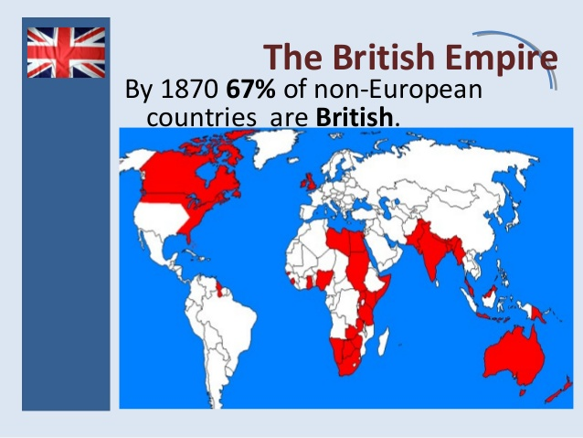
The Consolidation of English Language

Slide 42
English Today
By the 19th century, English has become the largest language in the world
Today the English vocabulary outstrips every other by a margin of almost two to one
Estimated: 300 million native speakers, 300 million English as a second language speakers, 100 million use it as a foreign language
It is the language of science, aviation, computing, diplomacy, and tourism
It is listed as the official or co-official language of over 45 countries
and is spoken extensively in other countries where it has no official status
This compares to 27 for French, 20 for Spanish and 17 for Arabic

