Slide 1
Geospatial Technology in Climate Change
Dr. Dinesh Kumar
Assistant Professor
Department of Environmental Sciences
Central University of Jammu, Jammu

Slide 2
OUTLINE
Understanding the Climate change
Understanding the Geospatial technology
Geospatial technology for Climate change

Slide 3
Concept of Climate
Weather- “the state of the atmosphere with respect to heat or cold, wetness or dryness, calm or storm, clearness or cloudiness”.
Climate – “the average course or condition of the weather at a place usually over a period of years as exhibited by temperature, wind velocity, and precipitation”. Climate is the average weather at a given point and time of year, over a long period (typically 30 years).
We expect the weather to change a lot from day to day, but to remain relatively constant for a longer period.

Slide 4
Contd..
If the climate doesn’t remain constant, we call it climate change. The key question is what is a significant change and this depends upon the underlying level of climate variability. Crucial to understand difference between climate change and climate variability.
Climate change is a long-term continuous change (increase or decrease) to average weather conditions (e.g. average temperature) or the range of weather. Both can also happen simultaneously.
Climate determines the type and location of human-managed ecosystems, such as agricultural farmlands.
Climate affects the weathering of rock, the type of soil that forms, and the rate of soil formation.

Slide 5
Contd..
Climate change is slow and gradual, and unlike year-to-year variability, is very difficult to perceive without scientific records.
Scientific tools and techniques analyze and look into the pattern of climate variability.
Geographic information system is one of the tools which is designed to handle spatial and temporal data at very flexible range.

Slide 6
Geographic information systems (GIS)
GIS are computer-based systems that can deal with virtually any type of information about features that can be referenced by geographical location.

Slide 7
Contd..
Geospatial techniques are capable of handling both locational and attribute data.
Geospatial technique combines layers of information about a specific geographic location to provide a better understanding of that location in a spatial context.
A Geospatial technique is a system (hardware + database engine) that is designed to efficiently, assemble, store, update, analyze, manipulate, and display geographically referenced information (data identified by their locations).

Slide 8
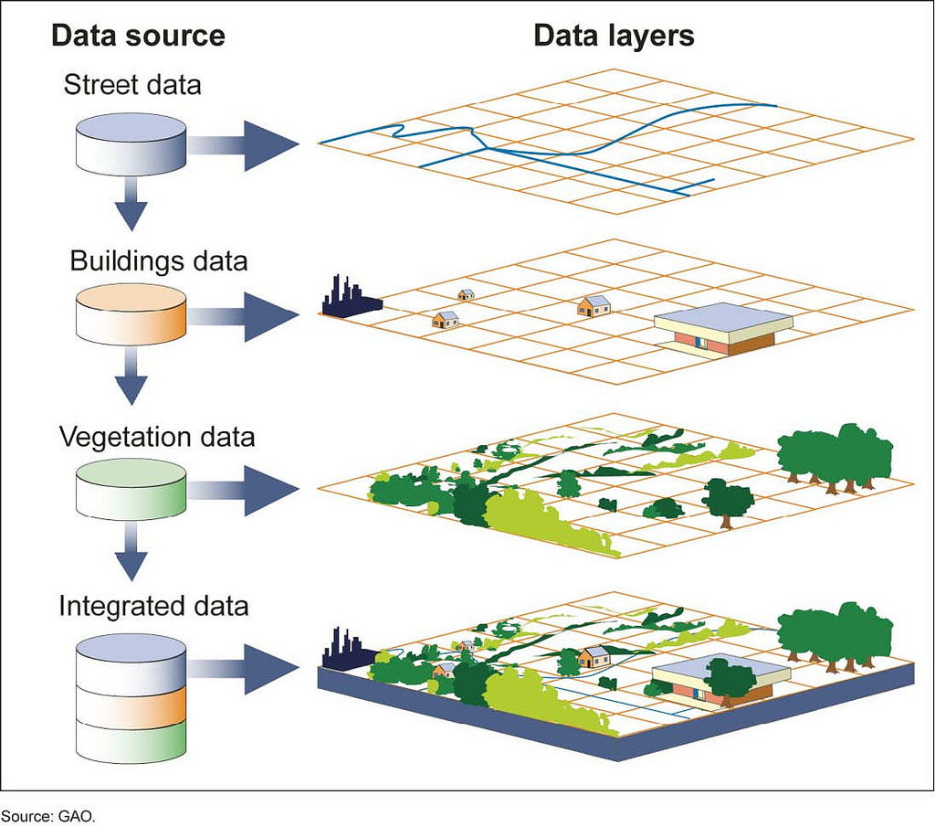

Slide 9
Geographic Information Systems
Define problem
Define problem
Decision
Decision
GIS
Process
GIS
Process
Define GIS criteria
Output
Define GIS criteria
Output
Import or build datasets
GIS analysis
Import or build datasets
GIS analysis
Notes:
GIS PROCESS:
The GIS process involves six steps that are common to what we refer to as the end to end map-making process.
1. Define the spatial problem/question.
.Define the GIS criteria.
.Import or create the data sets
.Perform the GIS analysis
.Create the output
.Decide whether or not the output solves or answers the spatial problem/question. If not, then refine the problem and start the process again.

Slide 10
GIS and Climate Change
A GIS-based framework helps us gain a scientific understanding of earth systems at a truly global scale and leads to more thoughtful, informed decision making:
Deforestation analysis spurs successful reforestation programs and sustainable management.
Study of potential sea level rise leads to adaptive engineering projects.
Emissions assessment brings about research into alternative

Slide 11
Contd..
Climate change is a geographic problem and GIS users represent a vast reservoir of knowledge, expertise, and best practices in applying this cornerstone technology to the science of climate change and understanding its impact on natural and human systems.
Climate scientists work with thousands of data sets, often cross-checking, merging, morphing and manipulating it into something useful.

Slide 12
How GIS is effective in Climate change Study
Studying the chemical composition of gases extracted from ice cores (Across a geographic area, between areas, or from different timeframes in the same area)
Extrapolating atmospheric forcings from each other in order to show the different factors affecting global warming
The spatial mapping of average global or regional temperatures helps to identify hot spots where where change has been more erratic or above average.

Slide 13
Contd..
Climate modelling enables to understand the futuristic scenario on the basis of available spatio-temporal data using Geospatial tools how our ecology might look 10, 50 or 100 years from now.
Scientists for years have been using sophisticated computer models such as general circulation, atmosphere-ocean interaction, and radiative convective process models in an attempt to visualize the future of earth’s climate.
By combining data from multiple sources, both past and future, gives us the best chance for a comprehensive and accurate vision of what the future holds.

Slide 14
Mapping the Impacts of Climate Change
Source: Center For Global Development

Slide 15
Contd..
Source: Center For Global Development

Slide 16
Weather Forecasting
Source: ISRO
Various satellite datasets and service providers are available which can be analyzed on GIS Platform
Oceansat-2
INSAT series
NASA-NOAA
EUMETSAT (European Meteorological Agency)
European Centre for Medium range Weather Forecasting (ECMWF)

Slide 17
Conclusion
Geospatial Techniques as a tool has enormous potential to study, analyze in various domain.
Geospatial Techniques can map the various aspects of climate on regional to global scale providing the decision makers a support system to develop an emergency support system.
Geospatial Techniques can predict the futuristic scenario for different climate variables.

Slide 18
References
ArcNews magazine, (2006), Summer
ISRO, Department of Space, GOI
www.environmentalscience.org
http://www.cgdev.org/ (Centre for global Development)

Slide 19
THANK YOU
FOR
YOUR ATTENTION

