Slide 1
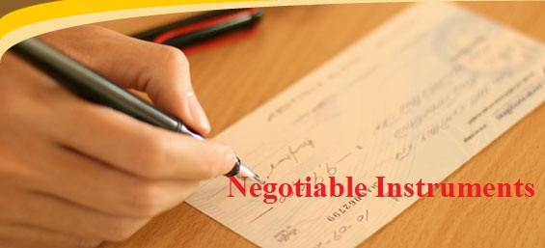
TOPIC: Meaning of Negotiable Instruments
Course Name | Business Law
Course Code | PGHRM2C005T
Course In Charge | Anjali Pathania

Slide 2
Concept of the Act
Law which is relating to negotiable instruments is contained in the Negotiable Instruments Act, 1881 which applies and extends to the whole of India.

Slide 3
Concept of Negotiable Instrument
Negotiable means ‘transferable by delivery,’ and the word instrument means ‘a written document by which a right is created in favour of some person.’
The term “negotiable instrument” literally means ‘a written document which creates a right in favour of somebody and is freely transferable by delivery.’
A negotiable instrument is a piece of paper which entitles a person to a certain sum of money and which is transferable from one to another person by a delivery or by endorsement and delivery.

Slide 4
Types of Negotiable Instruments
Negotiable instruments are of two types which are as follows:
Negotiable Instruments recognized by status:
e.g. Bills of Exchange, Cheque and Promissory Notes.
Negotiable instruments recognized by usage or customs of trade:
e.g. Bank notes, exchequer bills, share warrants, bearer debentures, dividend warrants, share certificate

Slide 5
1. Promissory Note
According to Section 4,
“A promissory note is an instrument in writing (not being a bank-note or a currency-note) containing an unconditional undertaking, signed by the maker, to pay a certain sum of money only to, or to the order of, a certain person, or to the bearer of the instrument.”

Slide 6
Essential features
An instrument is a promissory note if there are present the following elements:-
1. Writing
2. Promise to pay :
Case: Mange Lal Vs. Lal Chand, AIR 1995, Rajasthan High Court
3. Unconditional
Case: Roberts Vs Peake
4. Money only and a certain sum of money
5. Certainties of parties
6. Signed by the maker

Slide 7
2. Bill of Exchange
According to Section 5,
A “bill of exchange” is an instrument in writing containing an unconditional order, signed by the maker, directing a certain person to pay a certain sum of money only to, or to the order of, a certain person or to the bearer of the instrument.

Slide 8
Examples of Bills of Exchange
(1) A banker’s draft
(2) A demand draft even if it drawn upon another office of the same bank
(3) An order issued by a District Board Engineer on Government Treasury for payment to or order of a certain person.

Slide 9
3. Cheque
According to Section 6,
A “cheque is a bill of exchange drawn on a specified banker and not expressed to be payable otherwise than on demand and it includes the electronic image of a truncated cheque and a cheque in the electronic form.

Slide 10
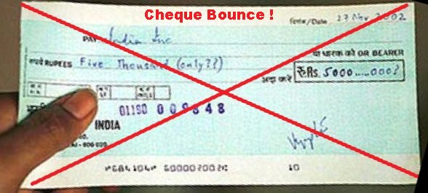
Section 6 : Cheque
For the purpose of this section, the expression
“ a cheque in the electronic form” means a cheque which contains the exact mirror image of a paper cheque, and is generated, written and signed in a secure system ensuring the minimum safety standards with the use of digital signature (with or without biometrics signature) and asymmetric crypto system
“ a truncated cheque” means a cheque is truncated during the course of a clearing cycle, either by the clearing house or by the bank whether paying or receiving payment, immediately on generation of an electronic image for transmission, substituting the further physical movement of the cheque in writing.

Slide 11
Dishonour Of Cheques
According to Sec. 138
Dishonour of cheque for insufficiency, etc. of funds in the account – where any cheque drawn by a person on an account maintained by him with a banker for payment of any amount of money to another person from out of that account for the discharge, in whole or in part, of any debt or other liability, is returned by the bank unpaid, either because of the amount of money standing to the credit of that account is insufficient to honour the cheque or that it exceeds the amount arranged to be paid from that account by an agreement made with that bank, such person shall be deemed to have committed that offence and shall, without prejudice to any other provision of this Act, be punishable with imprisonment for a term which may extend to 2 years with fine which may extend to twice the amount of the cheque or with both

Slide 12
Dishonour Of Cheques
Provided that nothing contained in the section shall apply unless –
(a) The cheque has been presented in the bank within a period of 6 months from the date on which it was drawn or within the period of its validity, which ever is earlier.
(b) The payee or the holder in due course of the cheque, as the case may be, makes a demand for the payment of the said amount of money by giving a notice, in writing, to the drawer of the cheque within 30 days of the receipt of information by him from the bank regarding the return of the cheque as unpaid; and
(c) The drawer of such cheque fails to make the payment of the said amount of money to the payee or , as the case may be , to the holder in due course of the cheque , within 15 days of the receipt of the said notice.

Slide 13
Dishonour Of Cheques
Case:
Electronics Trade and Technology Development Corporation Limited Vs Indian Technologists and Engineers Electronics Private Limited (1996)

Slide 14
THANK YOU

