Slide 1
Tourism : An Overview
Ranjeet Kumar Raman
Assistant Professor
Department of Tourism & Travel Management
School of Business Studies
Central University of Jammu

Slide 2
Learning objectives
Understand what tourism is and its definitions.
Learn the components of tourism and tourism management.
Examine the various approaches to studying tourism and determine which is of greatest interest to you.
Appreciate how important Tourism is for our Sustainable Planet.

Slide 3
Understanding Tourism
Tourism
The tourist
The businesses providing tourist goods and services
The government of the host destination
The host community

Slide 4
Integrated Definition
Tourism may be defined as the PROCESSES, ACTIVITIES, and OUTCOMES arising from the relationships and the interactions among tourists, tourism suppliers, host governments, host communities, and surrounding environments that are involved in the attracting and hosting of visitors.
Tourism is a composite of activities, services, and industries that deliver a travel experience.

Slide 5
UNWTO Definition of Tourism
The UNWTO has taken the concept of tourism beyond a stereotypical image of “holiday making.”
The officially accepted definition is:
“Tourism comprises the activities of persons traveling to and staying in places outside their usual environment for not more than one consecutive year for leisure, business, and other purposes.”
The term usual environment is intended to exclude trips within the area of usual residence, frequent and regular trips between the domicile and the workplace, and other community trips of a routine character.

Slide 6
Forms of Tourism
Tourism
International tourism
Internal Tourism
National Tourism
Domestic Tourism
Inbound tourism
Outbound tourism

Slide 7
Components of tourism and tourism management
Tourism is a complex phenomenon, one that is extremely difficult to describe succinctly.
Any “model” of tourism must “capture” the composition—or components— of the tourism system, as well as the key processes and outcomes that occur within tourism.

Slide 8
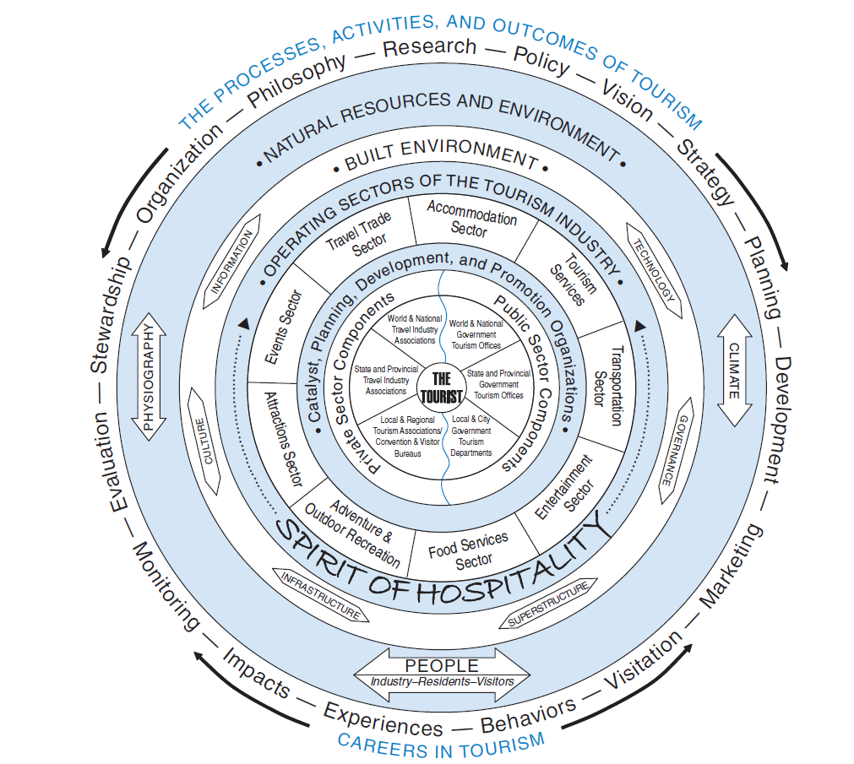
The tourism phenomenon: Components of tourism and tourism management

Slide 9
Approaches to the study of tourism
Institutional Approach
Product Approach
Historical Approach
Managerial Approach
Economic Approach
Sociological Approach
Interdisciplinary Approaches
The Systems Approach

Slide 10
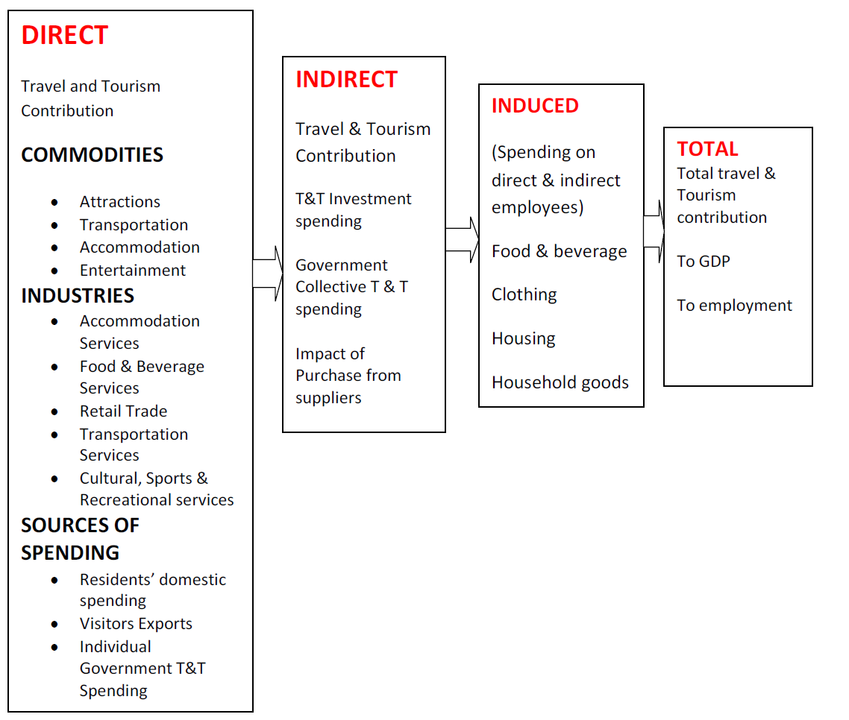
Travel and Tourism Contribution to Global Economy

Slide 11
Destination India: Tourism Business Opportunity
India’s fastest growing free market democracy is representative of the emergent realities in business and industry. At the same time, it also conveys a cohesive and unifying message about India's competitive advantage, one that most people easily identify with.
The brand portrays the distinctive qualities of all things Indian and has the dynamism to build an enduring reputation in the competitive global arena (IBEF).
In 21st century, India is passing through rapid growth which is stimulated by strength of Intellectual Capital and the unbridled Spirit of entrepreneurship. This trend has created key advantages for India.

Slide 12
ADVANTAGE INDIA | DESTINATION INDIA: GROWTH DRIVERS
World's largest democracy Stable political environment and responsive administrative set up. Well established judiciary to enforce rule of law. Land of abundant natural resources and diverse climatic condition Large pool of skilled manpower; strong knowledge base with significant English speaking population Young country with a median age of 30 years by 2025: India's economy will benefit from this "demographic dividend". Huge untapped market potential. Robust banking and financial institutions. Source: IBEF | Quality tourism infrastructure Promotional initiatives of MoT, GoI Relaxation of Visa Rules Starting of International Events Diverse offerings such as adventure, rural and wildlife tourism Tax incentives in the form investment Large inflow of FTAs every year Presence of large number of destinations The country’s big coastline provides a number of attractive beaches Globally renewed destination Cost-effective destination Diverse and large number of festivals Home to large number of rare species of animals and birds Large forest areas Large network of cannels, rivers and Inland, large coastline and strong positioning of port. Cost effective medical tourism Domestic spending on tourism is growing due to rising income and changing lifestyles (especially among young people) Central government has been increasing spending on tourism infrastructure; tourism has also emerged as a key focus area for individual state governments

Slide 13
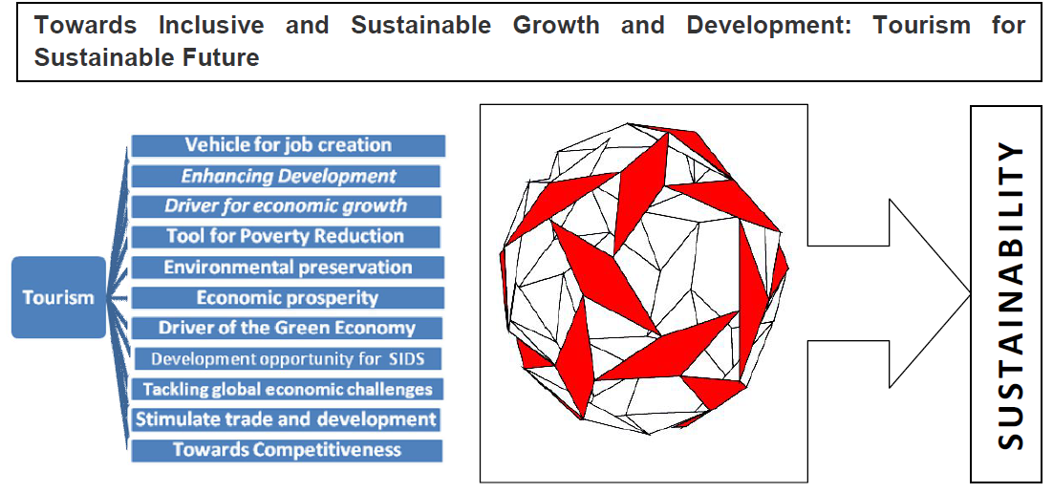
Concluding Remarks
Source: Author’s own conceptualization

Slide 14
References
Charles R. Goeldner, J. R. Brent Ritchie(2009).Tourism Principles, Practices, Philosophies Published by John Wiley & Sons, Inc., Hoboken, New Jersey.
Buhalis, D. (2000). Marketing the Competitive Destination of the Future, Tourism Management, 21, 97‐116

