Slide 1
Situation Analysis in Tourism
PESTEL Analysis

Slide 2
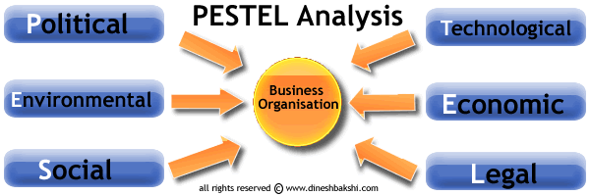

Slide 3
PESTLE is an analytical tool which considers external factors and helps you to think about their impacts
PESTLE analysis is a situation analysis tool used to analyse the impact of the external environment on a firm.
PESTLE analysis is used to evaluate the impact on a firm’s objectives and strategy of a change in any of the PEST/PESTLE factors

Slide 4
PESTEL vs SWOT
In contrast to a SWOT, PESTLE encourages you to think about the wider environment and what might be happening now and in the future which will either benefit or be of disadvantage to the organization, individual etc
It’s a kind of radar which picks up trends and developments in the external environment which can be used to inform longer term planning and strategy making

Slide 5
POLITICAL
These factors determine the extent to which a government may influence the economy or a certain industry. E.g. A government may impose a new tax or duty due to which entire revenue generating structures of organizations might change.
Political factors include –
Tax policies
Fiscal policy
Trade tariffs etc. that a government may levy around the fiscal year and it may affect the business environment (economic environment) to a great extent.

Slide 6
Economic
These factors are determinants of an economy’s performance that directly impacts a company and have resonating long term effects.
E.g. A rise in the inflation rate of any economy would affect the way companies’ price their products and services. Adding to that, it would affect the purchasing power of a consumer and change demand/supply models for that economy.
Economic factors include –
Inflation rate, interest rates, foreign exchange rates, economic growth patterns etc. It also accounts for the FDI (foreign direct investment) depending on certain specific industries who’re undergoing this analysis.

Slide 7
Social
These factors scrutinise the social environment of the market and gauge determinants like –
Cultural trends
Demographics
Population analytics etc.
An example for this can be buying trends for Western countries like the US where there is high demand during the Holiday season.

Slide 8
Technological
These factors pertain to innovations in technology that may affect the operations of the industry and the market favourably or unfavourably. This refers to automation, research and development and the amount of technological awareness that a market possesses.

Slide 9
Legal
These factors have both external and internal sides. There are certain laws that affect the business environment in a certain country while there are certain policies that companies maintain for themselves. Legal analysis takes into account both of these angles and then charts out the strategies in light of these legislations. For example, consumer laws, safety standards, labour laws etc.

Slide 10
Environmental
These factors include all those that influence or are determined by the surrounding environment. This aspect of the PESTLE is crucial for certain industries particularly for tourism, farming, agriculture etc.
How people’s perception and reaction to environmental issues can affect a business.

Slide 11
Issues of concern
The main problem with these external PESTLE factors is that they are continuously changing.
Therefore PESTLE analysis should include a thorough analysis of what is affecting the organization or a project Now, and what is likely to affect it in the Future.
The result of a PESTLE analysis is usually a list of positive and negative factors that are likely to affect a project.
However, by themselves, theses factors they mean very little.
It is important to bear in mind, that PESTLE analysis requires careful Application of results.

Slide 12
PESTEL analysis of Hilton Hotels, UK
Political
Political situation in Northern Ireland and other parts of UK
Acts of terrorism or threat of act of terrorism
Impacts of sanctions imposed on Russia
Possibility for UK to exit the EU
Economic
National macroeconomic situation in UK
Extent of economic growth in UK
Value of GBP against other major currencies
Rate of inflation

Slide 13
Social
Demographic changes in UK and worldwide
Changes in family patterns
Shifting values in society
Increasing role of social media
Technological
Technological breakthroughs in catering industry
Increasing integration of internet into various aspects of life
Advancing hotel booking functionalities
Environmental
Impact of changes in weather conditions
Potential damage to the brand image due to environmental pollution
Seasonality of catering business
Effects of natural disasters

Slide 14
Legal
Changes in UK rules and regulations related to catering industry
UK consumer protection rules and regulations
Immigration rules and regulations in UK

