Slide 1
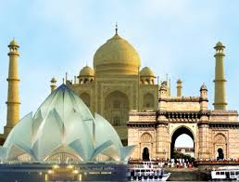
Inbound Tourism
Dr. Bharti Gupta
Assistant Professor
Department of Tourism & Travel
Course Code:PGTTM3C002T
Course Name
Inbound Operation Management

Slide 2
About tourism
Tourism is officially defined as:
The activities of persons travelling to and staying in places outside
their usual environment for not more than one consecutive year for
leisure, business and other purposes not related to the exercise of
an activity remunerated from within the place visited.

Slide 3
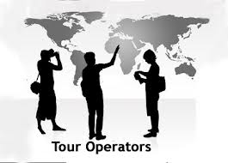
About Tour Operator
Tour operators play a very important role in travel and tourism, by arranging the package holidays that are such an important feature of life in the 21st century.
Tour operators are at the forefront of today’s travel and tourism sector, seeking out new destinations and holiday experiences to satisfy the ever-changing needs and expectations of travellers.
They work in partnership with airlines, hoteliers, car hire companies and a variety of other travel service suppliers to package their holiday products. Tour operators sell holidays through travel agents and direct to the public, with internet bookings showing dramatic rises in recent years.

Slide 4
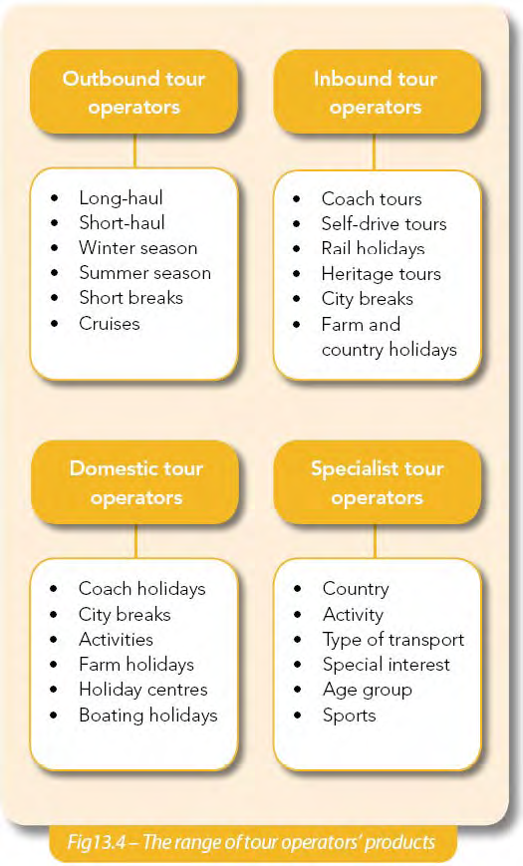
Tour Operators’ Products

Slide 5
Package Holiday
At its simplest, a package holiday is an arrangement that includes transport to a destination, accommodation, transfer arrangements and the services of a representative for an all-inclusive price
• Tour operators assemble these different components into a saleable product that meets the needs and expectations of the customer.
• They are sold though travel agents and via less traditional distribution channels, such as the internet, TV and call centres.

Slide 6
Dynamic Packaging
Dynamic packaging is when travellers use the internet to research their holidays and make their own travel arrangements direct with airlines, hotels, car hire companies, etc.
It offers people greater flexibility than buying standard holidays from a travel agency and can sometimes work out cheaper as well.

Slide 7
About Inbound Tourism
When a company focuses primarily on serving travellers coming from other destinations, we refer to them as inbound operators. They generally offer services for clients coming from other countries or regions.
The inbound operator seeks to understand foreign markets and develop products and services that will attract customers from overseas to their destination, and will focus on researching the travel motivations and preferences of target markets outside their own country.

Slide 8
About Inbound Tourism…………………………………………………………………………..…continued
Inbound tour operators create and market travel products and services to customers mainly in long haul markets. Customers in countries far away generally do not have in depth knowledge of a destination or the service providers in that destination, may not speak the language, and may not feel comfortable making their own arrangements. Inbound tour operators serve these customers by planning a holiday, and may offer experiences that would otherwise be inaccessible to independent travelers making their own arrangements.
For example, planning and organizing your own expedition to go trekking in Western Croatia would involve months of research to identify routes, find local guides, arrange transport and considerable expense to transport equipment and gear or purchase it locally.

Slide 9
About Inbound Tourism…………………………………………………………………………..…continued
A local company can organize all this for you at much less cost and in less time than it would take for you to do it yourself.
Inbound operators usually specialize in package travel arrangements of this kind, and may have both group and independent travelers as clients.
Inbound operators operate their own tours, although the services of many local companies may be packaged and resold as part of this tour.
Inbound operator usually specialize in one country or region. They may offer tours catering to a broad range of interests if they are in a country that is not well known to travellers, but if they are in a well known destination where it is easy for independent travellers to make their own arrangements they usually focus on specialty travel.

Slide 10
Examples of Inbound Tour in India
Yoga & Meditation Tours in India
Golden Triangle India Tours
Taj Mahal Tour Packages
Rajasthan Tour Packages
Ayurveda Tours in India
Kerala Backwaters Tours
North India Tours
Adventure Tours in India
Buddhist Tours in India
Wildlife Tours in India
Goa Travel Packages

Slide 11
 | Target Markets or Clients | Main Products/Services | Distribution Channels
Inbound Tour Operators | Travelers with an interest in a specific destination or activity, usually long haul travelers in other markets. | Package travel for groups or independent travelers in one destination or a region, may cover several areas of interest or be more focused, for groups or independent travelers. Products are usually designed in house, with some services from ground operators and local service providers resold as part of the package. Examples: 12 day trek in Western Mongolia, package tour of the Gobi Desert, homestay holiday with a nomadic family in Mongolia. | Sales to outbound tour operators, some direct sales to consumers and through resellers or portals. Targeted marketing via direct contacts with outbound tour operators, travel fairs, and to special interest groups in foreign markets via direct mail, special interest publications, and some direct marketing via website.

Slide 12
 | Target Markets or Clients | Main Products/Services | Distribution Channels
Travel Agencies | Mass market, general interest travel and package travel to more well known destinations | Flight and other travel arrangements, accommodation and event tickets, package tours for groups and individuals (for outbound). Products are mostly sourced from tour operators, ground operators, and local service providers, but also from travel resellers and portals. Examples: package cruise in the Mediterranean, all inclusive holiday in Turkey, beach holiday package in Spain with accommodation and flights. | Direct sales to consumers. Inbound agencies may sell to outbound agencies or place packages with resellers and portals. Mass marketing done through advertisement via direct mail, media, and via agency offices.

Slide 13
Benefits of Inbound Tourism
There are many benefits to export tourism including:
International travel patterns are not focused around weekends and may level out seasonality problems
Spreading risk across a range of international markets can minimise the impact of any changes in the domestic or a single international travel market
International travel market is growing and consumers from many overseas countries have expressed a high desire and intent to visit India.
Inbound distribution networks open up new forms of distribution and give millions of potential travellers around the world easy access to your product
International travellers are generally higher yield and spend, on average, three times more than domestic travellers on each trip
Lead times are generally longer, allowing better business planning
Opportunity to meet people from a range of cultures and backgrounds and be an ambassador for your country can be extremely rewarding.

Slide 14
Where to Start?
As with any business decision, before you begin to market to inbound travellers, it is important to do some research and planning. You will need to:
Understand the travel distribution system and its rate structure
Research international markets to establish who will use your products
Recognise the different travel styles of inbound tourists
Develop a marketing plan to target international visitors through a range of media and distribution channels, and
Seek advice from your Local, Regional and State tourism offices.

Slide 15
Detecting the Differences between Domestic and International Tourism
While marketing your product to international tourists has many benefits, there are a number of differences between domestic and international tourism markets including:
Overseas consumers, particularly long haul travellers, may have limited knowledge of the destination.
Marketing costs are higher overseas;
International markets vary considerably from country to country both in terms of travellers' needs and the structure of the travel distribution system
Itineraries are generally more complex than domestic itineraries
Selling travel products to the international travel trade usually requires a commitment to their pricing and commission structures over a long period of time
Language and cultural differences create additional challenges for both marketing and product delivery
Entering and establishing your business in the international market is a long term investment and it may take several years to recoup costs.

Slide 16
Know the Competition
It is important to understand that overseas markets are very competitive, often more so than the domestic market. Not only are you competing against companies that provide similar products, you are also competing against other international destinations. Therefore, it is recommended that you take a different approach to international marketing using different distribution channels and promotional media.
Limited consumer knowledge of India may lead to new promotional messages for your product that highlight the unique benefits of the destination and distinguish it from the rest of the world.
In the international arena, selling your region and educating travellers about your destination and its attributes is often the first step in selling your product.

Slide 17
The Role of ITO involves some of the following
One - stop- shop for the overseas agent.
Provides booking/reservation services
Provide package quotations.
Sources products and constructs packages.
Provide ground assistance for travelers.

Slide 18
Why work with an ITO
Marketing your product on your behalf..
Absorbing international communication and marketing expenses.
Expertise in handling global time variations, language barriers and cultural differences.
Financial risk taking.
Providing advice in product distribution methods suitable for your business.

Slide 19
INBOUND TOURISM CHECKLIST
Not all tourism products are suitable for marketing overseas. Some products may need to be refined before being marketed to inbound consumers, or may only suit specific markets or niche consumer segments. Other products may be more attractive to inbound markets as part of a package.
Before investing your time and money in the international market ask yourself the following questions:
Is your business established in the domestic market? Very few businesses enter the inbound market without first establishing themselves in the domestic market.
Do you have booking mechanisms in place for international markets?
Are you able to offer a booking confirmation via e mail or the internet within 24 hours? Phone and fax are less commonly used to make international reservation.

Slide 20
INBOUND TOURISM CHECKLIST…………………………………………………………………………………………………………….continued
Dou you understand the international distribution system and are you familiar with commission levels and pricing structures? You should allow upto 30 % commission for distribution through Inbound Tour Operators (ITOs) and wholesalers
Do you understand the concept of pricing? Be prepared to set rates and guarantee them 12-18 months in advance to coincide with the travel industry calendar in each target market.
Have you thoroughly researched the international markets to establish where your products fits? Tourism market information fact sheets provide specific information on international markets, visitor travel patterns, consumer preferences and travel distribution in selected source markets.

Slide 21
INBOUND TOURISM CHECKLIST…………………………………………………………………………………………………………….continued
7. Do you clearly understand the needs of international markets compared to domestic markets? It is important to consider the travel patterns, motivations and expectations of international travelers , as well as the language and cultural differences.
Do you have a distribution strategy which works through a range of media to target your consumers?
Have you developed a range of promotional material for you clients , both consumers and agents?
Have you researched opportunities to package your product with other complementary product in your region?

Slide 22
INBOUND TOURISM CHECKLIST…………………………………………………………………………………………………………….continued
Do you have an active quality assurance program to maintain your product to a recognized high standard? International travelers expect consistent levels of service, quality product and reliable operating schedules. In many cases, you and your travel trade partners will need to adhere to stringent consumer protection laws.
Are you prepared to work cooperatively with your State Tourism Organization, your Regional Tourism Associations and your Local Tourism Administration? These organisations can advise you about their international marketing efforts and offer a range of cooperative advertising and promotional opportunities.

Slide 23
Links between Tour Operators and other Travel & Tourism Industry
Tour operators work in partnership with many travel and tourism companies and organisations when developing and selling their holidays. Activity
Make a chart with details of the main ways in which tour operators work with travel agents, accommodation providers, ancillary service providers, surface transport operators, tourist attractions, airlines and regulatory bodies.

Slide 24
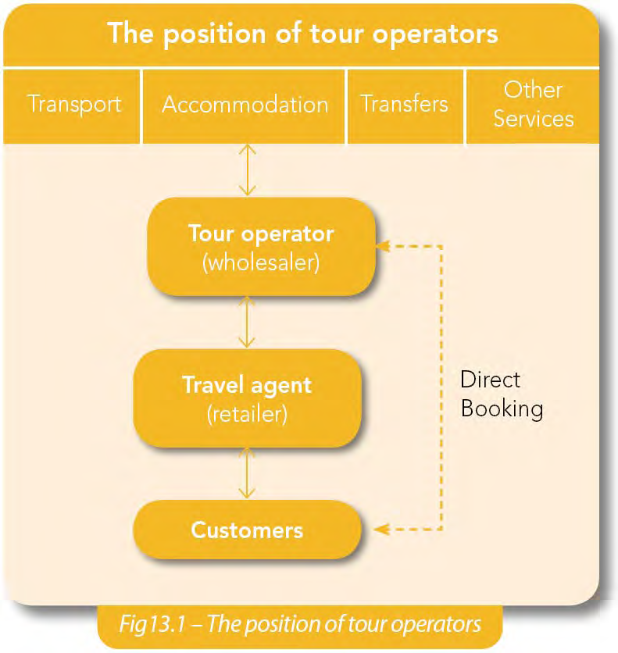

Slide 25
External Influences and Challenges to Tour Operators
Tour operators work in a very challenging and fast-moving business
environment, sometimes having to react to changing circumstances at very
short notice. They face many external influences on their work –
from natural disasters and terrorism to rising fuel costs and changes in customer demand.
The growth of the internet and low-cost airlines are changing the way that
people travel and forcing tour operators to change their businesses.

Slide 26
Natural Disaster
Natural disasters, such as hurricanes, volcanic eruptions, floods and
avalanches, can have serious consequences on an area’s travel
and tourism sector
• The Asian tsunami that affected Indian Ocean countries in late 2004
and Hurricane Katrina’s devastation of New Orleans in 2005 are
examples that are all too familiar, as is the hurricane that devastated
much of Haiti in January 2010
• The 2010 eruptions of the Icelandic volcano and subsequent ash
cloud over Europe is another case in point. Air travel was halted at
an instant, with serious consequences for airlines, tour operators
and other travel and tourism industries
• Although tourism can be badly affected very quickly when natural
disasters occur, the sector has proved itself to be very resilient in the
face of adversity

Slide 27
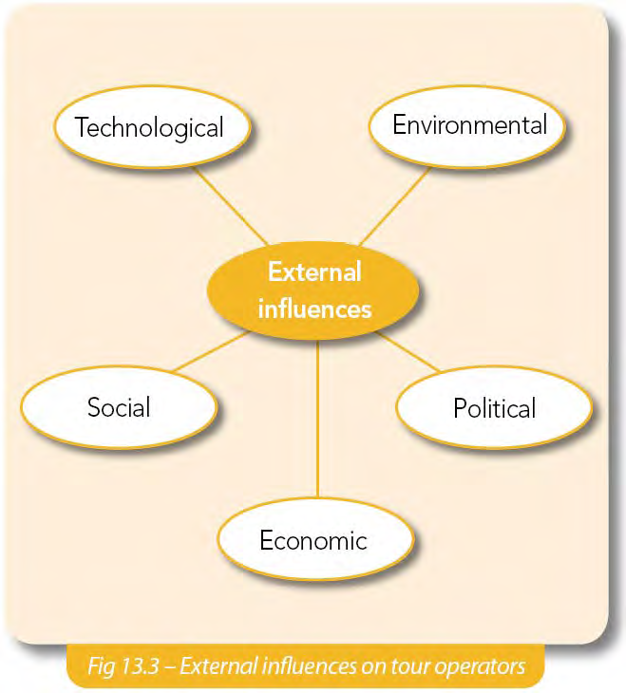

Slide 28
GOI Initiatives and Marketing Campaigns
The Ministry of Tourism, has played an important role in
the development of the industry, initiating advertising campaigns such as the
Incredible India campaign, which promoted India's culture and tourist
attractions in a fresh and memorable way projecting India as an attractive tourist destination by showcasing different aspects of Indian culture and history like yoga, spirituality, etc. The campaign, launched in 2002 to encourage visitors
from around the world to experience India helped create a colorful image of
India in the minds of consumers, and has directly led to an increase in the
interest among foreign tourists. This is reflected in the spurt in global tourist
inflows since 2002.

Slide 29
GoI initiatives and marketing campaigns………………………………………..continued
'Atithi Devo Bhavah', : In 2008, the Ministry of Tourism launched a campaign targeted at the local population to educate them regarding good behavior and etiquette when dealing with foreign tourists.
Indian actor Aamir Khan was commissioned to endorse the campaign which was titled 'Atithi Devo Bhavah', which aimed at creating awareness about the effects of tourism and sensitizing the local population about preservation of India's heritage, culture, cleanliness and hospitality.
The Atithi Devo Bhavah is a seven point programme of hospitality
and training, and it attempted to re-instill a sense of responsibility towards
tourists and re-enforce the confidence of foreign tourists towards India as a
preferred holiday destination.
The concept was designed to complement theIncredible India Campaign. The Ministry of Tourism had also launched a "Campaign Clean India" to sensitize the masses about keeping Indian destinations clean.

Slide 30
GoI initiatives and marketing campaigns………………………………………..continued
In 2009, plans were formulated to extend the Incredible India campaign to the
domestic tourism sector as well. As a result of the various lessons from the
earlier promotional activities, the new and revamped Incredible India campaign
has been launched recently which made a paradigm shift in the strategy to
promote Indian destinations abroad and within with two separate campaigns.
While the international campaign is called "Find what you seek", the domestic
campaign is titled as "Go Beyond". India's Tourism Minister Chiranjeevi said at
the World Tourism Mart (WTM) in London last year that the new campaign tries
to take the Incredible India campaign to the next level with shifting focus from
1 products to consumers . This is explicitly aimed at doubling the FTA in the next 5years by targeted promotion of the lesser known Indian destinations to the world tourists.
.

Slide 31
GoI initiatives and marketing campaigns………………………………………………….………………..continued
According to World Travel and Tourism Council forecasts, India will be a tourism
hotspot from 2009 to 2018, having the highest 10-year growth potential. The onset of the financial crisis in 2008 delayed the realisation of this potential,
which resumed in 2010. In recognition of the potential and domestic efforts,
India was conferred three awards by the World Travel Awards organization at the
WTM 2012. The three awards were "Asia's leading destination", "Asia's leading
tourist attraction - Taj Mahal" and "Asia's leading Tourist Board." The government
has also made additional provisions to promote creation of supporting tourism
th infrastructure in the 12 Five Year Plan, including provisioning for the projected
accommodation to be demanded (Table 4). The implementation of the National
Tourism Plan, 2002 has already intensified the infrastructure development
through better design and monitoring of the incentive schemes.

Slide 32
GoI initiatives and marketing campaigns………………………………………..continued
An additional boost to FTAs is being attempted through the Indian Tourist Visa on
Arrival (T-VoA) initiative, a facilitative measure in place since January 2010.
Visitors to India can now get a single entry T-VoA, valid for a maximum of 30
days, at the international airports in Delhi, Mumbai, Chennai, and Kolkata.

Slide 33
Recommended policy actions to promote FTA inflows in India are:
1) Both the union government and individual states should continue to
focus on innovative marketing campaigns and tourist facilitation
services to remain attractive to the footloose FTAs.
2) To boost inbound foreign tourism, the national government can waive
tourist visa fees in targeted destinations. Also, reimbursement of VAT
on purchases by foreign tourists can help boost inflows from the
South and Southeast Asian sub-regions and even Africa.

Slide 34
Recommendations………………………………………………………………………………………………………continued
Improving destination connectivity, wayside amenities and security will
boost word of mouth promotion. Cleanliness and security (in particular
for women) in and around the tourist sites is a key concern for foreign
tourists, and there is an urgent need to improve them. The recent
incidences of assaults on women in India (including foreign tourists)
have greatly damaged India's image and consequently tourism
Prospects.

Slide 35
Recommendations………………………………………………………………………………………………………continued
4)Standardization of rates and fares will also help boost foreign tourist
confidence vis-à-vis the prevalent feeling of being discriminated against
and cheated. Concerted efforts and strict penal actions must also be
taken to reduce incidents of tout and harassment of tourists in some
places.
5) The high tourist spend per person in India is a welcome feature.
However, in times of slowdown such as now, concerted efforts to offer
value for money will encourage more mid-range and budget travelers to
come to India, thus helping the country to tap a major chunk of foreign
travellers who are now visiting the comparable locales in other
competing countries.

Slide 36
Recommendations………………………………………………………………………………………………………continued
6)Rationalization of the tax structure and licensing regime will help
promote development of quality low-cost and mid-range
accommodation and other tourist services such as transport. This is
particularly critical in the luxury tax for hotels.
7) Extending the infrastructure status to 'all' hotels and tourist
accommodation units can also assure development of lower cost
accommodation. Sector experts reckon that hotel tariffs may actually
go down by 2-3 percent if the government agrees to remove the riders
attached to the infrastructure status accorded to the hotel industry
recently.

Slide 37
Recommendations………………………………………………………………………………………………………continued
8)Absence of alternate sites near fair and festival creates a bottleneck
problem in crowd management. Mega festivals like Kumbh mela or
Gangasagar mela should be accorded special attention from the local
administration/civic management bodies and emergency services
providers.
9) Poor Implementation of Legislative Law: Excessive formalities for an
issue of special permit to view restricted areas/heritage sites dampen
tourist interest and hence need to be streamlined.

Slide 38
what is required for the growth of Inbound Tourism in India that is not being provided today by the stakeholders in tourism.
· Neat and clean hotels in remote places
· Budget hotels
· Last mile road connectivity catering to smooth and seamless travel
· Security and safety for tourists
· Visa on arrival for at least all western countries
· Better infrastructure in Tier II cities
· Knowledgeable guides
· Greater awareness on accessibility
· To look at new markets
· More thrust on promotion of India in mainland China and Latin American countries
· Promoting destinations collectively
· Recognizing tourism as an Industry and grant it export industry status

Slide 39
Thank you
Acknowledgement: Planning Inbound Tourism Success, Volume 3

