Slide 1
Adventure Tourism Management

Slide 2
Adventure Sports
Adventure Sports is a term for certain sports activities perceived as having a high level of inherent danger. These activities often involve speed, height, a high level of physical exertion, and highly specialized gear.
The commonly used definition is "a competitive (comparison or self-evaluative) activity within which the participant is subjected to natural or unusual physical and mental challenges such as speed, height, depth or natural forces and where fast and accurate cognitive perceptual processing may be required for a successful outcome" by Dr. Rhonda Cohen (2012)

Slide 3
Adventure Tourism
Adventure tourism is a type of niche tourism involving exploration or travel to remote areas, where the traveller should expect the unexpected. Adventure tourism is rapidly growing in popularity as tourists seek unusual holidays, different from the typical beach vacation. Mountaineering expeditions, trekking, bungee jumping, rafting and rock climbing are frequently cited as an examples of adventure tourism.

Slide 4
Components of Adventure Tourism

Slide 5
Typologies of Adventure Tourism
There are two main categories of adventure activities, hard adventure or soft adventure, and vigorous debate often surrounds which activities belong in each category. The easiest way to identify an adventure trip as hard or soft adventure is by its primary activity, level of difficulty involved & the level of skill involved. Listed below are some examples –
1. Archaeological expedition – Soft
2. Bird watching - Soft
3. Camping - Soft
4. Hiking – Soft
5. Trekking – Hard
6. Mountaineering - Hard

Slide 6
Adventure Tourism Motivators
The theory of motivation was first developed during the Post-World War II, more precisely during the 50s and 60s (Zehrer and Siller, 2007). The term Motivation is originated from the Latin word 'Movere', and this means 'to move' (Wing, 2011). Motivation can be defined as the process by which an individual will be determined to take action or behave in a certain manner (Decrop, 2006). Motivation is known to be one of the fundamental reasons to understand and explain why does behavior happened. (Snepenger, King, Marshall, and Uysal, 2006) in (Phan, 2010). Moreover, Solomon (2004) described motivation as a 'driving force' that pushes individuals to action. Motivation is all about a state of need and desire to do and achieve something (Moutinho, 2000) in (Esichaikul, 2012).

Slide 7
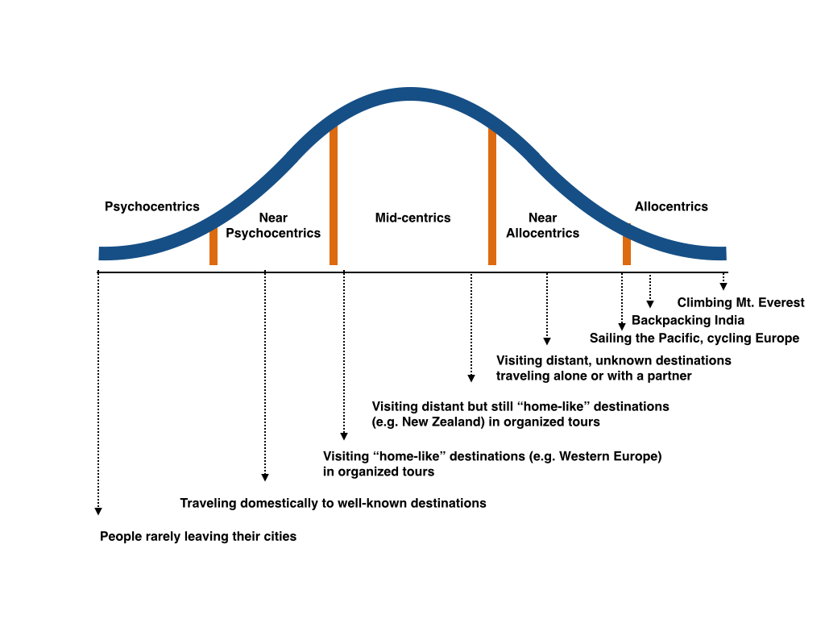

Slide 8
The reasons people engage in adventure travel are diverse, but the most often cited motivations are relaxation, exploring new places, time with family, and learning about different cultures.
Adventure travellers rank areas of natural beauty as the most important factor in choosing their most recent destination, followed by the activities available and the climate. Non-adventure travellers ranked having friends and family at the destination as the most important factor, followed by areas of natural beauty and climate.
According to the Adventure Tourism Market Study 2013, 57% of adventure travellers were male and 43% were female. However, the 2014 annual global trade study, which is specific to tour operators, reflected that 53% of their travellers were female and 47% of them male. The 2013 study further revealed that 37% of adventure travellers have at least a four-year degree, 11% have a professional degree, and the average individual income of an adventure traveller is USD 46,800 per year.
When compared with non-adventure travelers, adventure travelers were more likely to use professional services, such as guides, tour operators and boutique service providers. In examining only adventure travelers, however, it is found that 56% of still handle everything on their own.

Slide 9
Global Trends & Emerging Markets
Adventure tourism is one of the fastest growing sectors of the tourism sector, attracting high value customers, supporting local economies, and encouraging sustainable practices. Thus, the continued growth of this sector creates net positive impacts not only for tourism, but also for destination economies, their people, and their environment.
In 2010, the first global adventure tourism market sizing study was conducted by the ATTA, The George Washington University (GWU) and Xola Consulting.1 It found that the global value of adventure tourism was USD 89 billion. The study was repeated in 2013 and found that 42% of travellers departed on adventure trips, making the sector worth USD 263 billion—an increase of 195% in two years.2 This remarkable growth was attributed to-
1) An increase in international departures 2) An increase of travellers going on adventure trips 3) An increase in average spending.
Source - ATTA, The George Washington University (GWU) and Xola Consulting

Slide 10
69% of overall international departures originate in Europe, North America, or South America; the same is true of adventure tourism. Between 2009 and 2010, South America’s adventure hard travel population grew from 1.4% of all departures to 8% of all departures. The same time period saw a 5 % increase in the soft adventure population. In fact, the UNWTO Tourism Highlights 2014 notes that “with rising levels of disposable income, many emerging economies have shown fast growth over recent years, especially in markets in Asia, Central and Eastern Europe, the Middle East and Africa.” Additionally, the report notes that Chinese travelers are the top spenders while on vacation. Developed economies will benefit from the favourable exchange rate for Russian and Chinese travelers via inbound tourism. Meanwhile, countries like the United Kingdom will experience healthier levels of domestic tourism due to the reduced purchasing power of their local currency. Widespread increases of projected arrivals from Russian, Chinese, and Latin American travelers will be changing the shape of leisure traveler demographics in the years to come. The AdventurePulse: USA Adventure Traveler Profiles, a study of the United States of America adventure travel market, indicates 71% of the United States of America adventure travelers are making arrangements solely on their own.
The trend of disintermediation which is very prominent in mature adventure markets will likely cause changes in developing countries supply chain in the coming decades.
Source – UNWTO, Global Report on Adventure Tourism, AM Reports: Volume nine

