Slide 1
Presented by
Dr. Jehova Jire L. Hmar
(jehovajire52@gmail.com)
Assistant Professor
Department of Physics & Astronomical Sciences Central University of Jammu, India
May 15 , 2017.
Law of gravitation, Kepler’s Laws and Dielectrics

Slide 2
Lecture 1

Slide 3
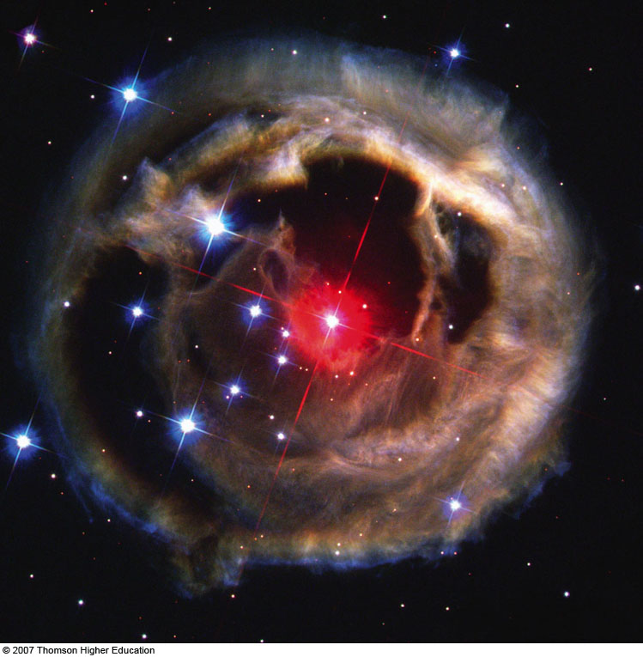
Dr. J. J. L. Hmar
Universal Gravitation
Newtonian Gravitation
Free-fall Acceleration & the Gravitational Force
Gravitational Potential Energy
Escape Speed
Kepler 1st Law
Kepler 2nd Law
Kepler 3rd Law

Slide 4
Dr. J. J. L. Hmar
Newton’s Law of Universal Gravitation
The apple was attracted to the Earth
All objects in the Universe were attracted to each other in the same way the apple was attracted to the Earth

Slide 5
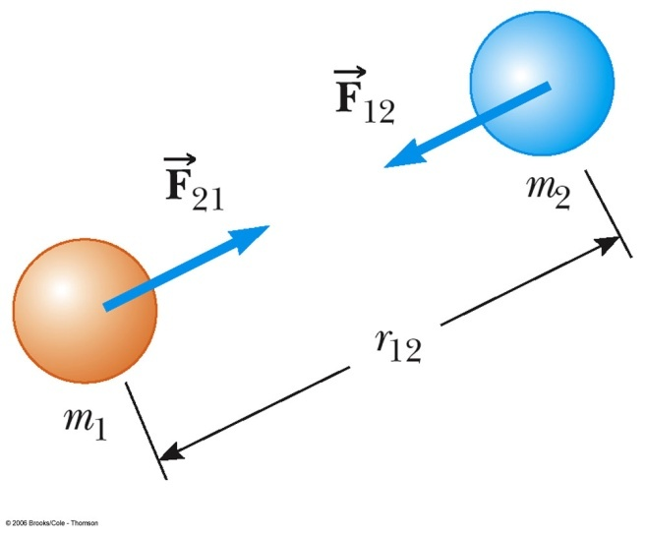
Dr. J. J. L. Hmar
Newton’s Law of Universal Gravitation
Every particle in the Universe attracts every other particle with a force that is directly proportional to the product of the masses and inversely proportional to the square of the distance between them.

Slide 6
Dr. J. J. L. Hmar
Universal Gravitation
G is the constant of universal gravitation
G = 6.673 x 10⁻¹¹ N m² /kg²
This is an example of an inverse square law
Determined experimentally
Henry Cavendish in 1798

Slide 7
Dr. J. J. L. Hmar
Universal Gravitation
The force that mass 1 exerts on mass 2 is equal and opposite to the force mass 2 exerts on mass 1
The forces form a Newton’s third law action-reaction
The gravitational force exerted by a uniform sphere on a particle outside the sphere is the same as the force exerted if the entire mass of the sphere were concentrated on its center

Slide 8
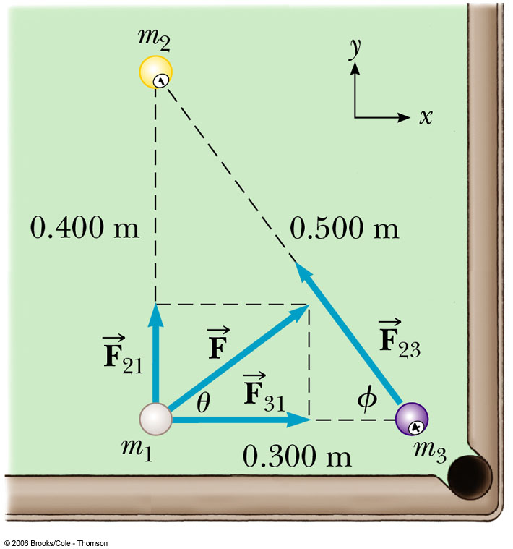
Dr. J. J. L. Hmar
Billiards, Anyone?
Three 0.3-kg billiard balls are placed on a table at the corners of a right triangle.
(i) Find the net gravitational force on the cue ball;
(ii) Find the components of the gravitational force of m₂ on m₃.

Slide 9
Lecture 2

Slide 10
Dr. J. J. L. Hmar
Free-Fall Acceleration
Have you heard this claim:
Astronauts are weightless in space, therefore there is no gravity in space?
It is true that if an astronaut on the International Space Station (ISS) tries to step on a scale, he/she will weigh nothing.
It may seem reasonable to think that if weight = mg, since weight = 0, g = 0, but this is NOT true.
If you stand on a scale in an elevator and then the cables are cut, you will also weigh nothing (ma = N – mg, but in free-fall a = g, so the normal force N = 0). This does not mean g = 0!
Astronauts in orbit are in free-fall around the Earth, just as you would be in the elevator. They do not fall to Earth, only because of their very high tangential speed.

Slide 11
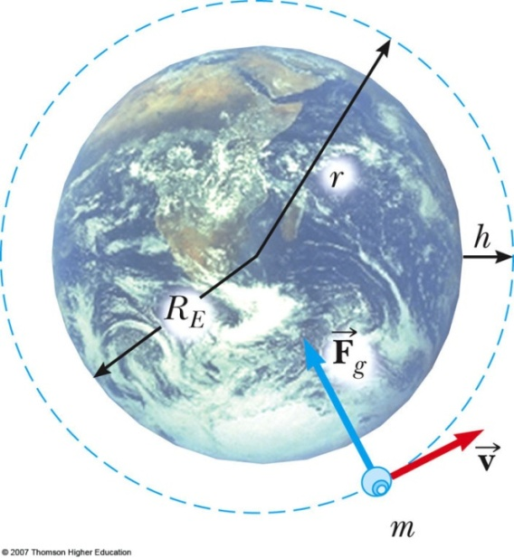
Dr. J. J. L. Hmar
Free-Fall Acceleration and the Gravitational Force
Consider an object of mass m near the Earth’s surface
Acceleration a_{g} due to gravity
Since
we find at the Earth’s surface

Slide 12
Dr. J. J. L. Hmar
Consider an object of mass m at a height h above the Earth’s surface
Acceleration a_{g} due to gravity
a_{g} will vary with altitude

Slide 13
Dr. J. J. L. Hmar
U = mgy is valid only near the earth’s surface
For objects high above the earth’s surface, an alternate expression is needed
Zero reference level is infinitely far from the earth, so potential energy is everywhere negative!
Energy conservation

Slide 14
Energy of an Orbit
Dr. J. J. L. Hmar
Consider a circular orbit of a planet around the Sun. What keeps the planet moving in its circle?
It is the centripetal force produced by the gravitational force, i.e.
That implies that
Making this substitution in the expression for total energy:
Note the total energy is negative, and is half the (negative) potential energy.
For an elliptical orbit, r is replaced by a:

Slide 15
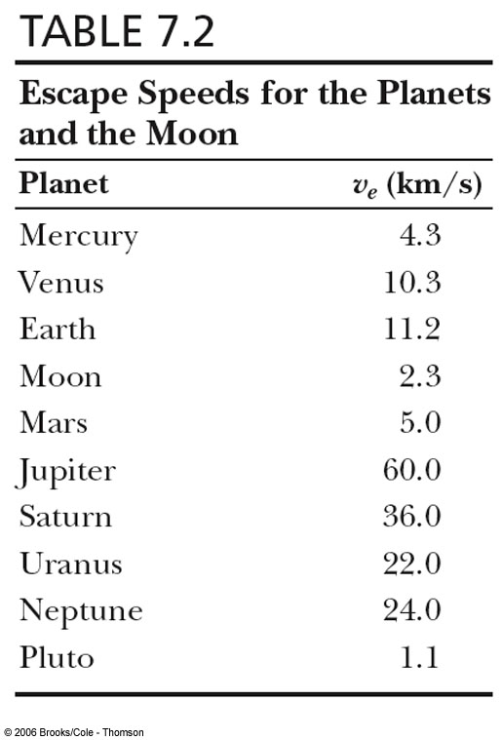
Escape Speed
Dr. J. J. L. Hmar
The escape speed is the speed needed for an object to soar off into space and not return
For the earth, v_{esc} is about 11.2 km/s
Note, v is independent of the mass
of the object

Slide 16
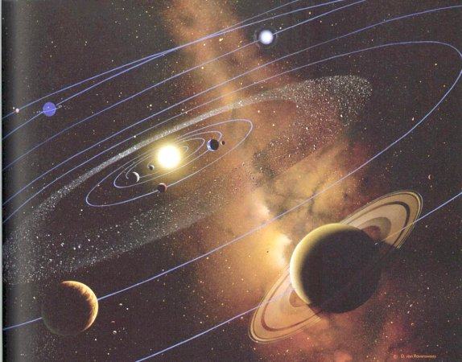
Dr. J. J. L. Hmar
Kepler’s Laws
All planets move in elliptical orbits with the Sun at one of the focal points.
A line drawn from the Sun to any planet sweeps out equal areas in equal time intervals.
The square of the orbital period of any planet is proportional to cube of the average distance from the Sun to the planet.

Slide 17
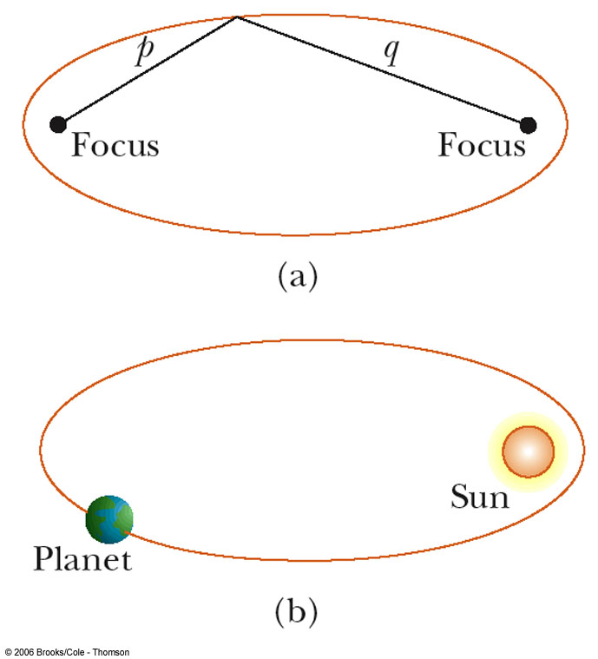
Dr. J. J. L. Hmar
Kepler’s First Law
All planets move in elliptical orbits with the Sun at one focus.
Any object bound to another by an inverse square law will move in an elliptical path
Second focus is empty

Slide 18
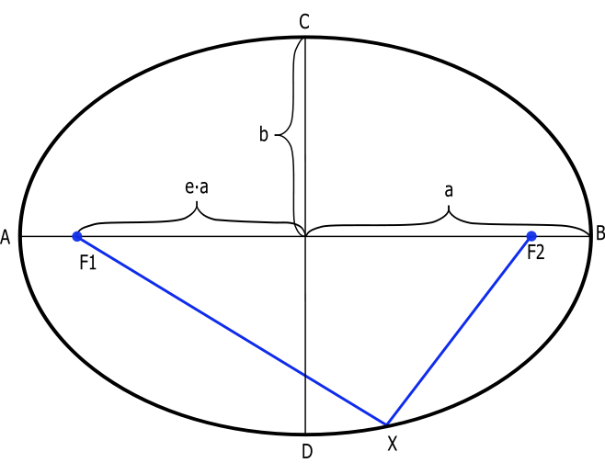
Dr. J. J. L. Hmar
Ellipse Parameters
Distance a = AB/2 is the semi-major axis
Distance b = CD/2 is the semi-minor axis
Distance from one focus to center of the ellipse is ea, where e is the eccentricity.
Eccentricity is zero for a circular orbit, and gets larger as the ellipse gets more pronounced.

Slide 19
Dr. J. J. L. Hmar
Kepler’s Second Law
A line drawn from the Sun to any planet will sweep out equal areas in equal times
Area from A to B and C to D are the same

Slide 20
Dr. J. J. L. Hmar
Kepler’s Third Law
The square of the orbital period of any planet is proportional to cube of the average distance from the Sun to the planet.
T is the period of the planet
a is the average distance from the Sun. Or a is the length of the semi-major axis
For orbit around the Sun, K = K_{S} = 2.97x10⁻¹⁹ s²/m³
K is independent of the mass of the planet

Slide 21
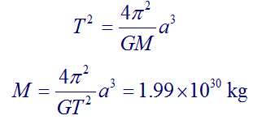
Dr. J. J. L. Hmar
The Mass of the Sun
Calculate the mass of the Sun noting that the period of the Earth’s orbit around the Sun is 3.15610⁷ s and its distance from the Sun is 1.49610¹¹ m.

Slide 22
Lecture 3

Slide 23
Dielectrics
Dr. J. J. L. Hmar
Dielectrics are the materials having electric dipole moment permanently.
Dipole: A dipole is an entity in which equal positive and negative
charges are separated by a small distance..
DIPOLE moment (µ_{ele} ): The product of magnitude of either of the
charges and separation distance b/w them is called Dipole moment.
µ_{e} = q . x → coul – m
All dielectrics are electrical insulators and they are mainly used to store electrical energy.
Ex: Mica, glass, plastic, water & polar molecules…
q
-q
X

Slide 24
Dr. J. J. L. Hmar
dipole
+
_
+
Electric field
_
+
_
+
_
_
+
+
_
+
_
+
_
+
_
Dielectric atom
Dielectric Constant
Dielectric Constant is the ratio between the permittivity of the medium to the permittivity of free space.
The characteristics of a dielectric material are determined by the dielectric constant and it has no units.

Slide 25
Dr. J. J. L. Hmar
Polar and Non-polar Dielectrics
To investigate the dependence of the polarization on molecular quantities it is convenient to assume the polarization P to be divided into two parts: the induced polarization P_{α} caused by the translation effects, and the dipole polarization P_{μ} caused by the orientation of the permanent dipoles.
A non-polar dielectric is one whose molecules possess no permanent dipole moment.
A polar dielectric is one in which the individual molecules possess a dipole moment even in the absence of any applied field, i.e. the center of positive charge is displaced from the center of negative charge.

Slide 26
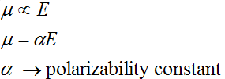
Dr. J. J. L. Hmar
Electric Polarization
The process of producing electric dipoles by an electric field is called polarization in dielectrics.
Polarizability:
The induced dipole moment per unit electric field is called Polarizability.
The induced dipole moment is proportional to the intensity of the electric field.
Is a Polarizability constant

Slide 27
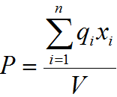
Dr. J. J. L. Hmar
Polarization vector:
The dipole moment per unit volume of the dielectric material is called polarization vector.

Slide 28
Dr. J. J. L. Hmar
Electric flux Density (D)
Electric flux density is defined as charge per unit area and it has same units of dielectric polarization.
Electric flux density D at a point in a free space or air in terms of Electric field strength is
At the same point in a medium is given by
As the polarization measures the additional flux density arising from the presence of material as compared to free space

Slide 29
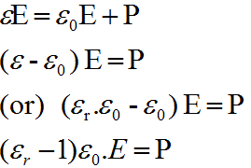
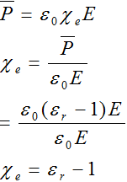
Dr. J. J. L. Hmar
Using equations 2 & 3 we get
Electric susceptibility:
The polarization vector P is proportional to the total electric flux density and direction of electric field. Therefore the polarization vector can be written

Slide 30
Lecture 4

Slide 31
Dr. J. J. L. Hmar
Various polarization processes:
When the specimen is placed inside a d.c. electric field, polarization is due to four types of processes….
1. Electronic polarization
2. Ionic polarization
3. Orientation polarization
4. Space charge polarization

Slide 32
Dr. J. J. L. Hmar
Electronic Polarization
When an EF is applied to an atom, +vely charged nucleus displaces in the direction of field and ẽ could in opposite direction. This kind of displacement will produce an electric dipole with in the atom.
i.e, dipole moment is proportional to the magnitude of field strength and is given by
where ‘α_{e}’ is called electronic Polarizability constant

Slide 33
Dr. J. J. L. Hmar
It increases with increase of volume of the atom.
This kind of polarization is mostly exhibited in Monatomic gases.
He | Ne | Ar | Kr | Xe
0.18 | 0.35 | 1.46 | 2.18 | 3.54

Slide 34
Dr. J. J. L. Hmar
Expression for Electronic Polarization
Consider a atom in an EF of intensity ‘E’ since the nucleus (+Ze) and electron cloud (-ze) of the atom have opposite charges and acted upon by Lorentz force (F_{L}).
Subsequently nucleus moves in the direction of field and electron cloud in opposite direction.
When electron cloud and nucleus get shifted from their normal positions, an attractive force b/w them is created and the separation continuous until columbic force F_{C} is balanced with Lorentz force F_{L}, Finally a new equilibriums state is established.

Slide 35
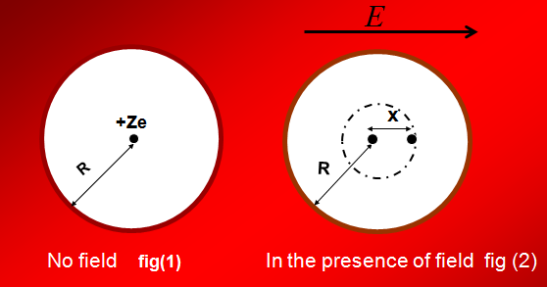
Dr. J. J. L. Hmar
Fig(2) represents displacement of nucleus and electron cloud and we assume that the –ve charge in the cloud uniformly distributed over a sphere of radius R and the spherical shape does not change for convenience.

Slide 36
Dr. J. J. L. Hmar

Slide 37
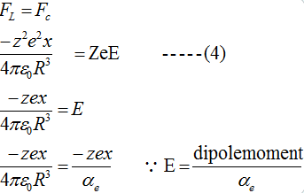
Dr. J. J. L. Hmar
Force experienced by displaced nucleus in EF of Strength E is F_{L} = Eq = ZeE -----(3)
Hence electronic Polaris ability is directly proportional to cube of the radius of the atom.

Slide 38
Dr. J. J. L. Hmar
Ionic polarization
The ionic polarization occurs, when atoms form molecules and it is mainly due to a relative displacement of the atomic components of the molecule in the presence of an electric field.
When a EF is applied to the molecule, the positive ions displaced by X₁ to the negative side electric field and negative ions displaced by X₂ to the positive side of field.
The resultant dipole moment µ = q ( X₁ + X₂)..

Slide 39
Dr. J. J. L. Hmar
Electric field
_
+
_
+
+
_
anion
cat ion
+
_
+
_
+
_
+
_
+
_

Slide 40
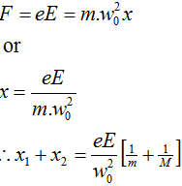
Dr. J. J. L. Hmar
Restoring force constant depend upon the mass of the ion and natural frequency and is given by

Slide 41
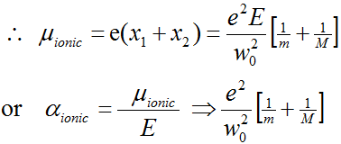
Dr. J. J. L. Hmar
Where ‘M’ mass of anion and ‘m’ is mass of cation
This polarization occurs at frequency 10¹³ Hz (IR).
It is a slower process compared to electronic
polarization.
It is independent of temperature.

Slide 42
Dr. J. J. L. Hmar
Orientational Polarization
It is also called dipolar or molecular polarization. The molecules such as H₂ , N₂,O₂,Cl_{2 ,}CH₄,CCl₄ etc., does not carry any dipole because centre of positive charge and centre of negative charge coincides. On the other hand molecules like CH₃Cl, H₂O,HCl, ethyl acetate (polar molecules) carries dipoles even in the absence of electric field.
However the net dipole moment is negligibly small since all the molecular dipoles are oriented randomly when there is no EF. In the presence of the electric field these all dipoles orient them selves in the direction of field as a result the net dipole moment becomes enormous.
It occurs at a frequency 10⁶ Hz to 10¹⁰Hz.
It is slow process compare to ionic polarization.
It greatly depends on temperature.

Slide 43
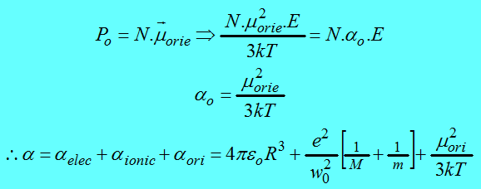
Dr. J. J. L. Hmar
Expression for orientation polarization
This is called Langevin – Debye equation for total Polaris ability in dielectrics.

Slide 44
Dr. J. J. L. Hmar
Local field or internal field in a dielectric is the space and time average of the electric field intensity acting on a particular molecule in the dielectric material.
Internal fields or local fields
Evaluation of internal field
Consider a dielectric be placed between the plates of a parallel plate capacitor and let there be an imaginary spherical cavity around the atom A inside the dielectric.
The internal field at the atom site ‘A’ can be made up of four components E₁ ,E₂, E₃ & E₄.

Slide 45
Dr. J. J. L. Hmar
+
+
+
+
+
+
+
+
+
+
+
_
_
_
_
_
_
_
+
+
+
+
+
+
Dielectric
material
+
+
_
A
_
_
_
Spherical
Cavity
+
+
+
_
_
+
_
_
+
+
+
_
_
_
_
_
_
_
_
_
_
E

Slide 46
Dr. J. J. L. Hmar
Field E₁:
E₁ is the field intensity at A due to the charge density on the plates
Field E₂:
E₂ is the field intensity at A due to the charge density induced on the two sides of the dielectric.
Field E₃:
E₃ is the field intensity at A due to the atoms contained in
the cavity, we are assuming a cubic structure, so E₃ = 0.

Slide 47
Dr. J. J. L. Hmar
+
+
+
+
+
+
+
+
+
+
+
+
_
_
_
_
E
_
_
_
_
_
_
_
_

Slide 48
Dr. J. J. L. Hmar
Field E₄:
1. This is due to polarized charges on the surface of the spherical cavity.
Where dA is Surface area between θ & θ+dθ…
2. The total charge present on the surface area dA is…
dq = ( normal component of polarization ) X ( surface area )

Slide 49
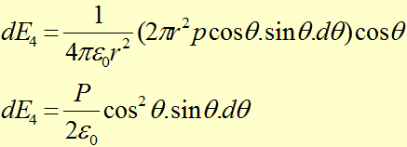
Dr. J. J. L. Hmar
3. The field due to this charge at A, denoted by dE₄ is given by
The field in θ = 0 direction

Slide 50
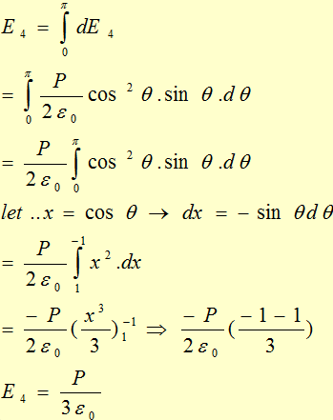
Dr. J. J. L. Hmar
4. Thus the total field E₄ due to the charges on the surface of the entire cavity is

Slide 51
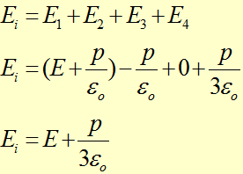
Dr. J. J. L. Hmar
The internal field or Lorentz field can
be written as

Slide 52
References :
A Treatise on Heat : Including Kinetic Theory of Gases, Thermodynamics and Recent Advances in Statistical Thermodynamics By Meghnad Saha, B. N. Srivastava ( Indian Press,1958)
Heat and Thermodynamics : An Intermediate Textbook By Mark Waldo Zemansky, Richard Dittman ( McGraw- Hill, 1981).
Thermodynamics By Enrico Fermi (Courier Dover Publication, 1956)
Electricity and Magnetism By Edward M. Purcell (McGraw-Hill Education, 1986)
Fundamentals of Electricity and Magnetism by Arthur F. Kip (Mc Graw-Hill, 1968)
Electricity and Magnetism by J. H. Fewkes & John Yarwood. Vol. l (Oxford Univ. Press, 1991).

Slide 53
Thank You

