Slide 1
Introduction to Travel Agency and Tour Operations Business
To understand the basic concept
of Travel Agency Management
and Tour Operation.

Slide 2
Tourism Industry
Accessibility
Attractions
Accommodation

Slide 3
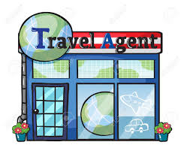
Concept- Travel Agency
A travel agent may be an individual/firm or corporation which is commonly known as travel agency.
An agency means office of the travel agent or organisation where all travel goods and services are assembled and coordinated for the smooth conduct of travel agency business.
A Travel Agent is one who makes arrangements of tickets for travel by air, rail, ship, passport, visa, etc. It may also arrange accommodation, tours, entertainment and other tourism related services (Acc. To MoT, GoI)

Slide 4
Concept: Travel Agency
Main features of a travel agency business are:
An important link between the clients and principal suppliers.
Image builder.
Ensures rapid travel service.
Provider of authentic and reliable travel information.
A social and continuous process.
Establishes good relationship with clients and vendors.

Slide 5
CONCEPT: TOUR OPERATION
Tour Operator
An organization, firm or company which buys individual travel components, separately from their suppliers and combines them into a package tour, which is sold with their own price tag to the public directly or through middlemen is called a tour operator.
-If a tour operator is to offer a package, also known as an inclusive tour, it will normally have to include at least two elements that are offered for sale at the inclusive sale price, and will involve a stay of more than 24 hours in overnight accommodation. These elements normally include transport, accommodation and other tourist services.
Poyhter (1993) defines tour operator is one who has the responsibility of putting the tour ingredients together, marketing it, making reservations and handling actual operation.
Notes:
Roles of tour operators are given below.
➢➢ It is a wholesaler as it assembles packages as per the trend of market and capacity of
distribution channel.
➢➢ It deals with customers directly as a principal agent or foreign travel agent without
off-loading tours to ground handling agents.
➢➢ Tour operator has liberty to amend the tour itinerary and program if it warrants.
➢➢ It invests much of time and resources to chart out delightful and value added tour
itinerary for meeting the demand and expectation of tourists.
➢➢ It gives much stress on selling the tour than the conducting the tour.
➢➢ Tour operators are mostly located in the mega cities or in the cities with the
international airlines services for the strategic advantage of controlling the package
tours.
➢➢ It mostly provides international transfer from hotel to airport and vice-versa, if
offices of tour operators are located.
➢➢ It deals with both the tourists and primary service providers as direct intermediary.
➢➢ Tour operators design the tours in such a way that handling agents may not get extra
excursion tours directly from tourists.
➢➢ It accepts foreign currency for the tour package and gets accreditation from the
Reserve Bank of India money exchange dealer.
➢➢ It gives ample importance to become the professional member of national and
international tourism, travel, and hospitality and aviation associations.
➢➢ It is committed to work as a responsible partner in the tourism industry to popularize
destinations and explore new potential destinations through their package tours.

Slide 6
Nature of Primary Activities of Different Tour Operators
➢ Inbound – Describing places of important of the country
➢ Outbound – Highlighting holidays about other countries
➢ Domestic – Specializing on domestic holidays within country
➢ Specialist – Special interest travel to destinations
➢ Independent- Specialized in specific holiday
➢ Integrated – Business Conglomerate
➢ Mass-market- Targeting more sale

Slide 7
Difference between a Travel Agency and a Tour Operator
 | Travel Agency | Tour Operator
System of Providing Service to Customers | Independent Reseller | Forms a single tourist product with its own price tag.
Size of the Organsation | Small | Large
Nature | Supplier | Distributor
Ground services | Less inclined | Act as ground operators
Dealing | May deal with one component | Offers a variety of tour programmes
Notes:
Difference between Travel Agencies and Tour Operators
• The major difference between tour operators and travel agencies is in the system of providing service to customers. A tour operator is a company that buys certain services from different companies (like hotels, restaurants, cafes, beauty salons) and forms a single tourist product out of them using its own pricing system. A travel agency acts like an independent reseller. Its profit is the commission for the sale of the operator's tours to customers. That's why the agent's price is usually higher, although there are moments when agents deliberately understate their prices.
• Usually a tour operator is a comparatively large company in comparison with a travel agency. It has its main office and several subsidiaries in order to offer their services to more potential customers. Many big tour operators have subsidiaries in different countries. Irrespective of the number of subsidiaries a tour operator usually concludes agent agreements with independent travel agencies that then sell the operator's tours to their customers. The more partners a tour operator has in as many countries and regions as possible, the more the sales volume is and, correspondingly, the more tourists will buy its tours and the more profit it will gain.
• A tour operator may be a supplier (meaning they might own hotels or car rentals or both) and allow to use their own inventory or their supplying partner inventories for a fee. A travel agent is only a distributor, and typically travel agents rarely own any travel assets (such as car rentals or hotels) of their own
• Travel agencies are less inclined than tour operators to perform ground services i.e. to act like a handling agency or ground operator.
• A travel agency may deal with one component of travel product while a tour operator offers a variety of tour programmes.

Slide 8
Types of Travel Agencies
Two major types:
Wholesale Travel Agency
e.g. Thomas Cook, Raj Tours and Travels, Mercury Travels etc.
Retail Travel Agency
e.g. Columbus Travels, Akbar Travels Of India Pvt Ltd.
Notes:
Wholesale Travel Agency
The business of wholesaling in tourism industry is no way different from the
wholesaling in the commodity market. A wholesale travel agency assembles different
components of services to design tour packages for catering FIT and GIT customers. A
wholesaler is one who initiates the process of forming organized tours or sells the individual
components directly or indirectly through franchise or retail agents. For example, a
wholesaler of Singapore airline or Taj Hotel or Sterling Time Share Group is authorized
to sell the airline tickets or hotel rooms on behalf of the principal service providers. A
wholesaler may be a consolidator or a manufacturer of tours or General Sales Agent (GSA).
It buys service components in bulk from different suppliers and it designs package and sells
or resells these components together.
If it is tour wholesaler, the process starts from the research development followed by
itinerary preparation. The most critical role of a tour wholesaler is the pricing of package
that positions the product in the market. Thus, tour wholesaler buys the service in bulk
from the primary or direct service providers. It means that bulk of hotel rooms and airline
seats is sold in a target time period for which wholesalers receive special commission. The
GSA of British Airways also appoints the retail travel agents to sell the tickets.
On the other hand, a wholesale travel agent is appointed to promote the sales of
outbound package tour in a particular region. Many retail travel agents are also authorized
to retail the outbound package tour in smaller cities and towns. The commission is paid to
retail agents periodically.
It however depends on retailer agencies to promote the products. Wholesaler
travel agents may also directly sell to the customers through their own retail divisions. For
example, Thomas Cook has its own network of branch offices in big cities to directly sell
tour packages to customers. In many cases, Thomas Cook appoints retail travel agents. It
generates revenues through volume discounts from principal services providers such as
hotels, airlines, railways, car rentals, coach operators, ground handlers etc.
A wholesaler doesn’t earn on commissions directly and it earns revenue through
discounts on bulk reservations from principal suppliers. There is always an element of
market risk for tour operators to block airline seats or hotel rooms in bulk. It takes the risk
of selling them in advance for which advance payments are made to the primary service
providers. Apart from the usual services, it also renders services like consultancy, travel
counseling, travel document processing, currency exchanges, insurance, shipping items etc.
The wholesale travel agencies in India are Raj Tours and Travels and Mercury Travels which
are also the full-service travel agents.
Retail Travel Agency
According to Airlines Reporting Corporation (ARC), a retail travel agency is defined
as “a business that performs the following functions: quotes fares, rates, makes reservations,
arranges travel tickets and accommodation, arranges travel insurance, foreign currency,
documents and accepts payments”.
A retail travel agency is one that sells directly to customers at several small locations
in cities or towns. Retailer gets commission from the gross sale of hotel rooms, airline,
train, bus and cruise tickets, insurance, foreign exchange, etc. Commission is the primary
source of its revenues. A two-way selling method, that a large travel agent practices, includes
commission and mark-up price. A marked-up price refers to mark up of cost of tour. It is
sold on a higher price. Further, market-up price is obtained from the difference between
retail price and the wholesale cost. The role of retail travel agencies is crucial when majority
of principal service providers have no choice to increase the sale without the help of retail
travel agents. Thus, there is a mushrooming growth of retail travel agents dealing with the
booking of hotel rooms, airlines seats, cruise line seats, etc. They consider in reaching the
customers through retail agents or getting the hotel or airline promoted through retailers
easy, reasonable and sustainable.
Full Service Agency
It is a type of travel agent that deals with all kinds of services. It may be called as
complete travel agents. Apart from being an accredited agent of IATA or any other principal
service providers, this full-service travel agent owns the transport fleets and charter flights
and cruises.
Commercial Agency
It is a category of unconventional travel agency that deals with business travel.
It books convention centers and stalls in exhibition center. It also arranges venue for
conducting small and large meetings.
Implant Agency
It is a type of travel agent that is located in the premises of corporate offices to
make travel arrangements of employees. It is a registered travel agent appointed as per the
agreements.
Group / Incentive agency
It is an emerging form of travel agency business that a specialized category of agent
acts as intermediary to deal with bulk bookings for employees and clients of corporate
houses.
Online Travel Agency
It resembles an offline travel agency in all its services. It operates on the internet
through a website connected to a global distribution system. The OTAs apply the operational
mechanisms of e-commerce and transact online with their customers. The OTAs offer
information, bookings of hotels, cars, reservation of seats in airlines, railways, ships and
buses. They sell package tours; customize tours and take enquiries. Transaction of payment
is also done online using online payment modes such as credit/debit cards, internet banking,
pay-pal etc. Some of the major OTAs in India are cleartrip, goibibo, travelocity, travelguru,
yatra.com. makemytrip.com etc.

Slide 9
Other Types of Travel Agency
Full Service Agency
Commercial Agency
Implant Agency
Group / Incentive agency
Online Travel Agency

Slide 10
Types of Tour Operators
According to the MoT, GoI, tour operators can be classified as:
Inbound Tour Operators
An Inbound tour operator is one who makes arrangements for transport, accommodation, sight seeing, entertainment and other tourism related services for foreign tourists
Tourist Transport Operators
A Tourist Transport Operator Organization is one, who provides tourist transport like cars, coaches, boats etc. to tourists for transfers, sightseeing and journeys to tourist places etc.
Adventure Tour Operators
An Adventure Tour Operator is one who is engaged in activities related to Adventure Tourism in India namely, water sports, aero sports, mountaineering, trekking and safaries of various kinds, etc. In addition to that he may also make arrangements for transport, accommodation, etc.
Domestic Tour Operators
A domestic tour operator is one who makes arrangements for transport, accommodation, sight seeing, entertainment and other tourism related services for domestic tourists.

Slide 11
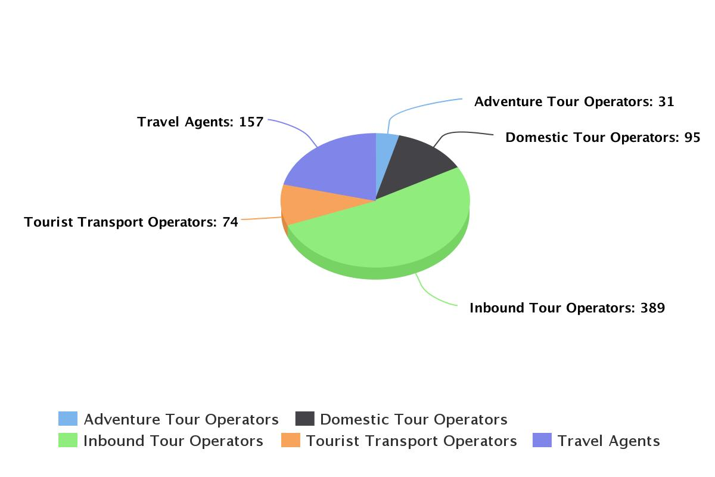
No. of Travel Trade Operators Recognized From MoT, GoI

Slide 12
Linkages of Travel Agency Business
Tour Wholesalers
Lodging Cos
Transport
Ministry of External Affairs
Insurance Cos
Banking Cos
Foreign Travel Cos
Tourism Associations
Govt. DoT
Educational Institutions
Cultural and Entertainment Organizations
Notes:
Meaning of Linkages and Integration
Integration is an approach of doing things together. Business integration is a means
of combining generic talents and resources to produce best products or delivery quality
services. It is very common in manufacturing sector and it has become usual business
strategy to prefer integration for marketing and sales of products or producing products in
minimum costs. The primary objective of integration is to maximize output with least costs.
Cost cutting measure is one of the ways of reducing production cost. This leads to lower the
final price of products. Lowering the price can increase the market share.
Business integration is essentially important in travel and tour operation business as
each provider of service cannot provide complete services on its own. Thus, linkages and
integrations are common business practices in tourism business. A tour operator maintains
integration with another tour operator in another city for use of common resources.
A tour operator wishes to establish business link with hotels, airlines, railways,
transport operators, etc for optimizing resources. Integration enables a travel agent or tour
operator to increase its market share. It simultaneously reduces the risk of loss and fear of
competitive forces. There are horizontal and vertical integration in travel trade. The former
is meant for business linkage between airlines or among airlines and the later is known for
linkage between airline and hotel or between tour operators between cruise lines. There are
benefits of integration as well as risks of doing integration. These are the following benefits.
Economics of Scales
This concept is very common in business and it would be more appropriate in tour
operation and travel agency business. The volume of productions and sales would be more
that leads to providing more profits. The cost of production can be drastically minimized
with the help of integration. For example, a tour operator can take care of marketing, sales
and customer care of an airline or hotel operator or they can jointly do the marketing.
Avoidance of Middlemen
Integration can link the tour operator with primary service provider directly.
Consolidation of Market
Integration can increase the market share and it simultaneously helps in dominating
the market.
Control over Supply for More Bargaining Power
Merger and acquisitions can help travel agency and tour operator to have more
control over supply of package tours in market. The acquisition of SITA World Travel India
Ltd by Kuoni has increased the market share of outbound business of Kuoni. At the same
time, tour operator can secure some bargaining power for booking hotel rooms and airline
seats.
Horizontal Integration
It involves two tour operators or two travel agencies or two hotels and two airlines
for amalgamation of competitive product through merger or acquisitions. This integration
helps the players offer complementary products and minimize unfair competition. For
example, Thomas Cook has taken over TCI for inbound tours in India and LKP for foreign
exchange. Horizontal integration is established between producers of services offering
complementary rather than competitive products.
Vertical Integration
It is a type of integration that links between airline and hotel or tour operator and
airline or hotel for mutual benefits. For example, an airline gets integrated with tour operator
for sale of tickets and tour operator gets integrated with airline for more sales of tickets
leading to more commission. Big corporate airlines and hotel companies have owned travel
agencies at key destinations for increasing the volume of business and gaining competitive
edge over other competitors.
Needless to say, travel agency and tour operation business is facing cut-throat
competition due to the rising number of small players entering into the package tour
market. In the last two decades, many multinational travel companies have forayed into the
Indian market and posed serious challenge to the Indian traditional companies. This has
become possible due to change in government policies like deregulation of domestic and
international airlines under the Open Sky Policy, liberalization of guidelines for transport
operators, hotel and restaurant companies, theme parks, etc. Thus, integration is the need
of the hour due to the economic volatility and socio-political risk factors. It is however
important to note here that multinational travel companies like Cox and Kings and Kuoni
have thrown open challenges to India travel companies to seek their ways to become more
aggressive in selling package tours..
Linkages for Effective Distribution of Services
Tour operator is a partner of a dynamic travel distribution channel through which
buying and selling of package tours is possible in a long-term basis. The vertical integration
establishes continuous relationship with many direct and indirect providers of services to
tourists. Tour operators bring the principal suppliers to a common network. These principal
suppliers are transport operators, airlines and charter flights, cruise line companies, railways
and car rental companies, hotels and event mangers. They are selected on the basis of
location, existence, service quality, physical facility, credit facility, etc. Tour operators make
the final contacts with these service providers on the conditions that tourists are served at
the destinations. It is essential to have up-linking networks for arranging services and get
the services delivered directly through the primary service providers.
When tour operators are ready with package tour to be promoted in market, they prefer
to promote it through organized channels and in certain cases clients buy directly from
them. Figure highlights the selling of package tours to the end users (Tourists) through
online marketing or directing marketing or retail travel agents. What tour operators plan
for the sale of package tours is that they open new branches in big cities and appoint several
retail travel agents in the smaller cities. Tour operators also accredit retail agents by giving
franchises. They work together on the condition of 10 to 20 per cent commission and
performance based rewards. The detail distribution network is given in Figure

Slide 13
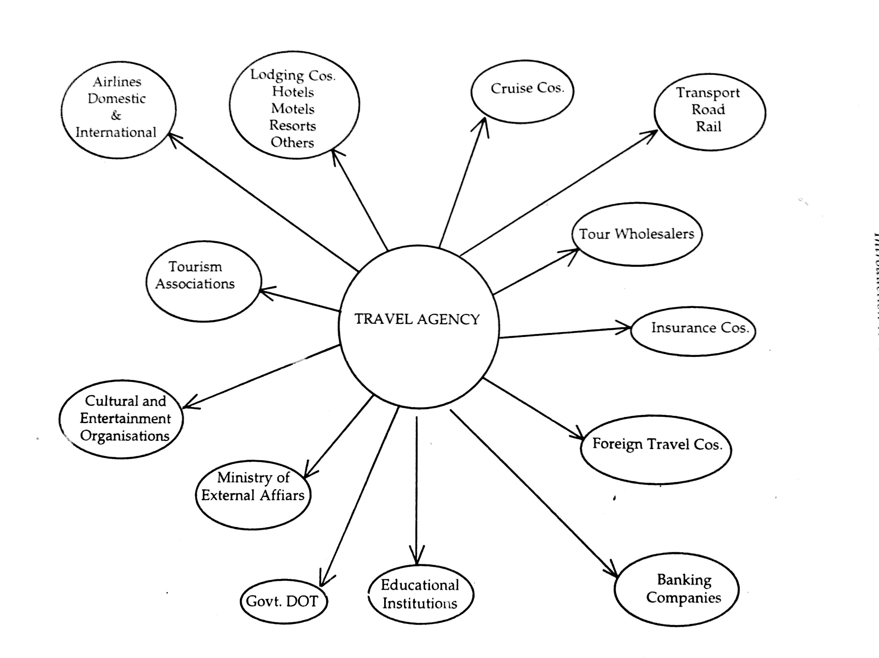

Slide 14
Setting up Travel Agency/Tour Operation Business
Market Research
Sources of Funding
Criterions for Starting of Travel Agency or Tour Operation Unit

Slide 15
Criterions for Starting of Travel Agency or Tour Operation Unit
Selection of Ideal Location
Selection of Office Premises
Selection of Furniture
Technological Gadgets
Paid-up Capital
Opening Current Account
Hiring and Retaining Qualified &Trained Staff
Customized Transport
Recognition from Airlines
Obtaining Franchise from Cruise Line and Multinational Travel Agency
Membership of Local, National and International Associations
Parking Area
Managing Capital and Cost
Cost on Obtaining IATA Recognition
Cost on Acquiring Latest Technological Gadgets and Transports

Slide 16
REFERENCES
Mohinder Chand, Travel Agency Management, Anmol: Delhi.
Stephen J. Page, Tourism Management An Introduction. Fourth Edition. Elsevier.
Chunk, James, Dexter & Boberg, Professional Travel Agency Management. Prentice Hall Publication
Fay Betsy, Essentials of Tour Management, New Jersey: Prentice Hall Publication.
Negi J.M., Travel Agency and Tour Operation: Concepts and Principles, New Delhi: Kanishka Publishers & Distributors.
http://tourism.gov.in
http://etraveltradeapproval.nic.in

