Slide 1
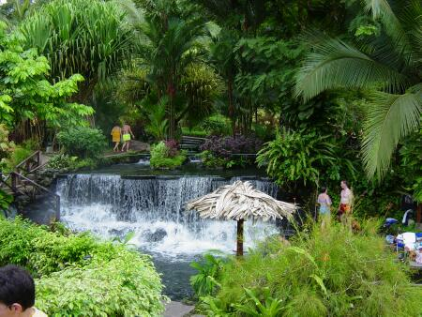
Sustainable Tourism
Dr. Bharti Gupta
Assistant Professor
Department of Tourism and Travel
Central University of Jammu.

Slide 2
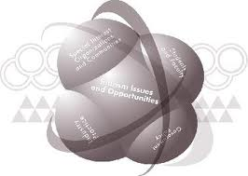
Defining Sustainability
Forms of progress that meet the needs of the present without compromising the ability of future generations to meet their needs.
World Commission on Environment and Development
It is important to consider that sustainability is about more than just looking after our natural environment. It is also about considering the social and economic impact of what we do and how we do it.

Slide 3
Defining Sustainable Tourism
It is tourism that could conceptually go on forever, i.e. tourism that doesn't use up any resources at a faster rate than their replenishment.

Slide 4
Defining Sustainable Tourism
“Tourism which leads to management of all resources in such a way that
economic, social and aesthetic needs can be fulfilled while maintaining cultural integrity, essential ecological processes, biological diversity and life support systems”
(WTO)
In addition they describe the development of sustainable tourism as a process which meets the needs of present tourists and host communities whilst protecting and enhancing needs in the future
(World Tourism Organisation 1996).

Slide 5
Related Phrases
Within the sustainability arena, there are several phrases that continually crop up. A few phrases that we often see are
Corporate Social Responsibility
Green Tourism,
Responsible Tourism
Triple Bottom Line Reporting
Source: United Nations Environment Programme and World Tourism Organisation, 2005)

Slide 6
Related Phrases
Corporate Social Responsibility is defined by the World Business Council for Sustainable Development as the continuing commitment by business to behave ethically and contribute to economic development while improving the quality of life of the workforce, their families and the local community and society at large. More than goodwill, corporate community involvement or strategic corporate philanthropy or corporate responsibility is a genuine attempt by a company to build meaningful relationships between the corporate sector and the rest of society.
Green Tourism is a broad reference to tourism experiences that focus on protecting the environment and allow visitors to travel responsibly, with little impact.
Triple Bottom Line Reporting means expanding the traditional reporting framework to take into account environmental and social performance in addition to financial performance. Triple Bottom Line reporting is becoming an accepted approach for organisations to demonstrate that they have strategies for sustainable growth. It focuses on decision-making and reporting which explicitly considers an organisation’s economic, environmental and social performance.
Responsible Tourism has emerged in recognition of the fact that eco-tourism should apply to all tourism, not just in natural areas or with nature-based experiences.
Source: United Nations Environment Programme and World Tourism Organisation, 2005)

Slide 7
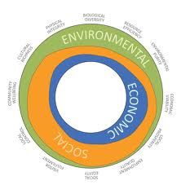
Three Dimensions or Pillars of Sustainable Development
Economic Sustainability
Social Sustainability
Environmental Sustainability
Source: United Nations Environment Programme and World Tourism Organisation, 2005

Slide 8
Economic Sustainability
It means generating prosperity at different levels of society and addressing the cost effectiveness of all economic activity. Crucially, it is about the viability of enterprises and activities and their ability to be maintained in the long term.
Source: United Nations Environment Programme and World Tourism Organisation, 2005

Slide 9
Social Sustainability
It means respecting human rights and equal opportunities for all in society. It requires an equitable distribution of benefits, with a focus on alleviating poverty.
There is an emphasis on local communities, maintaining and strengthening their life support systems, recognizing and respecting different cultures and avoiding any form of exploitation.
Source: United Nations Environment Programme and World Tourism Organisation, 2005

Slide 10
Environmental Sustainability
which means conserving and managing resources, especially those that are not renewable or are precious in terms of life support. It requires action to minimize pollution of air, land and water, and to conserve biological diversity and natural heritage.
Source: United Nations Environment Programme and World Tourism Organisation, 2005

Slide 11
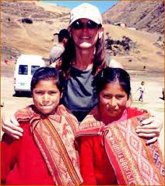
Tourism and Sustainable Development: A Special Relationship
Tourism is in a special position in the contribution it can make to sustainable
development and the challenges it presents.
Firstly, this is because of the dynamism and growth of the sector, and the major contribution that it makes to the economies of many countries and local destinations.
Secondly, it is because tourism is an activity which involves a special relationship between consumers (visitors), the industry, the environment and local communities. This special relationship arises because, unlike most other sectors, the consumer of tourism (the tourist) travels to the producer and the product.
This leads to three important and unique aspects of the relationship between tourism and sustainable development:
Interaction
Awareness
Dependency
Source: United Nations Environment Programme and World Tourism Organisation, 2005

Slide 12
Tourism and Sustainable Development: A Special Relationship…………………………Cont
Interaction: The nature of tourism, as a service industry that is based on delivering
an experience of new places, means that it involves a considerable amount of
interaction, both direct and indirect, between visitors, host communities and their
local environments.
Awareness: Tourism makes people (visitors and hosts) become far more conscious
of environmental issues and differences between nations and cultures. This can affect attitudes and concerns for sustainability issues not only while travelling but
throughout people’s lives.
Dependency: Much of tourism is based on visitors seeking to experience intact
and clean environments, attractive natural areas, authentic historic and cultural
traditions, and welcoming hosts with whom they have a good relationship. The
industry depends on these attributes being in place.
Source: United Nations Environment Programme and World Tourism Organisation, 2005

Slide 13
Tourism and Sustainable Development: A Special Relationship…………………………Cont
This close and direct relationship creates a sensitive situation, whereby tourism can be both very damaging but also very positive for sustainable development.
On the positive side, tourism can:
Provide a growing source of opportunities for enterprise development and employment creation as well as stimulating investment and support for local services, even in quite remote communities.
Bring tangible economic value to natural and cultural resources. This can result in direct income from visitor spending for their conservation, and an increase in support for conservation from local communities.
Be a force for inter-cultural understanding and peace.
Source: United Nations Environment Programme and World Tourism Organisation, 2005

Slide 14
Tourism and Sustainable Development: A Special Relationship…………………………Cont
Conversely, tourism can:
• Place direct pressure on fragile ecosystems causing degradation of the physical environment and disruption to wildlife.
• Exert considerable pressure on host communities and lead to dislocation of traditional societies.
• Compete for the use of scarce resources, notably land and water.
• Be a significant contributor to local and global pollution.
• Be a vulnerable and unstable source of income, as it is often very sensitive to actual or perceived changes to the environmental and social conditions of destinations.
Source: United Nations Environment Programme and World Tourism Organisation, 2005

Slide 15
Tourism and Sustainable Development: A Special Relationship…………………………Cont
Tourism has immense power to do good. Yet it can also be the vector for the very pressures that may destroy the assets on which it relies.
Developed without concern for sustainability, tourism can not only damage societies and the environment, it could also contain the seeds of its own destruction.
The net result is that all those involved in tourism have a huge responsibility to recognize the importance of its sustainable development.
Source: United Nations Environment Programme and World Tourism Organisation, 2005

Slide 16
Tourism and Sustainable Development: A Special Relationship…………………………Cont
For governments, tourism policies that address economic, social and environmental issues, and which are developed with an awareness of the potential both for harm and for benefit, can channel the forces resulting from the sector’s dynamic growth in a positive direction.
For the tourism industry, accepting this responsibility is not only about good citizenship, it should also be fuelled by a strong element of self interest, since any harm that is inflicted to the natural, cultural or social environment of destinations can lead to their eventual destruction or loss of value as a tourism product.
………………………………………………………………………………………………………………………
Source: United Nations Environment Programme and World Tourism Organisation, 2005

Slide 17
Key challenges for more sustainable tourism
Managing Dynamic Growth
Climate Change
Poverty Alleviation
Support for Conservation
Health, Safety and Security
Source: United Nations Environment Programme and World Tourism Organisation, 2005

Slide 18
The End

